Slide 1

PLA Search –User Manual
October 2020
Version 1.0

Slide 2
PLA Web Application Overview
Introduction
System walkthrough

Slide 3

Introduction
PLA Stands for Produktlebenslaufakte (Product life cycle document). PLA is web application used in Mercedes Benz Car Power train plants to improve the quality of production and assembly process.
A powertrain is a producer, converter and consumer of energy, all with the aim of getting the vehicle to move. The chain of components involved in the process is as follows:
Engine → Transmission → Flywheel → Driveshaft → Wheels
PLA is used in different power train plants like unterturkien

Slide 4
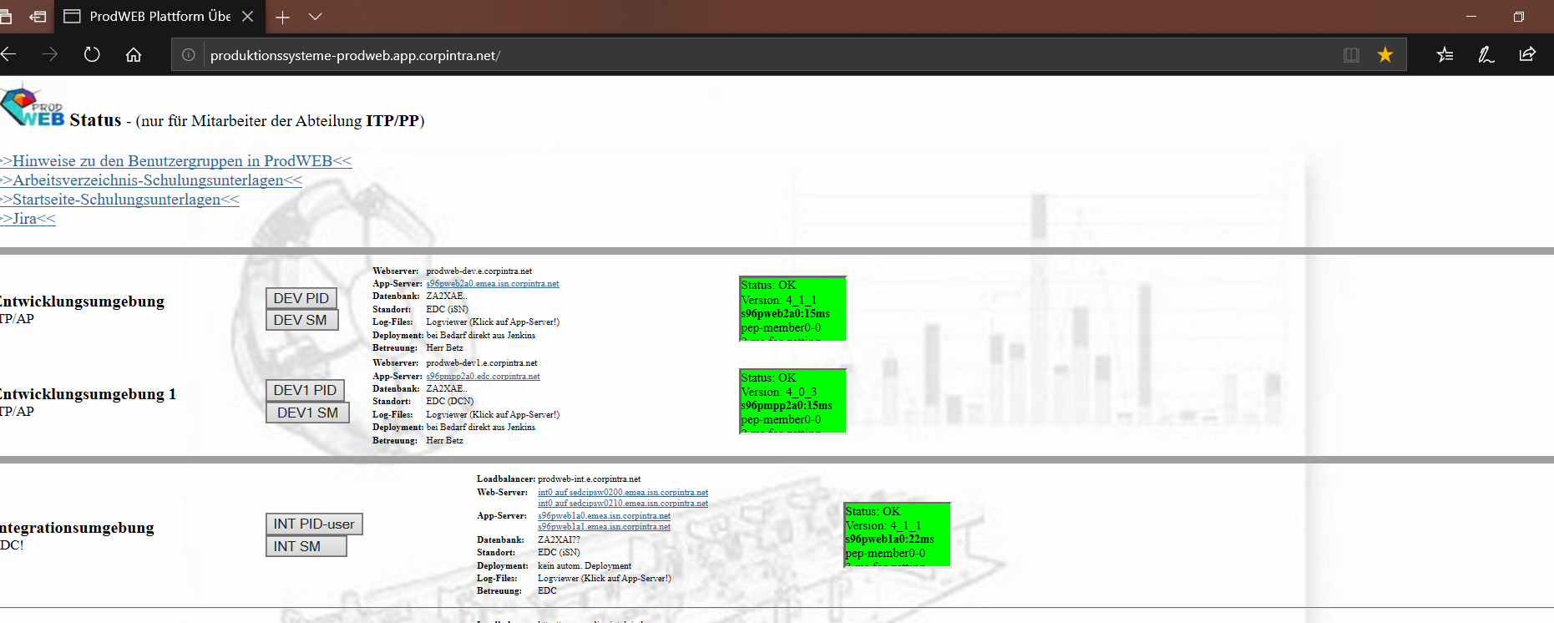
Initiation
Navigate to http://produktionssysteme-prodweb.app.corpintra.net/.
Click on Dev1 SM and Enter your credentials
Click on DEV1 SM

Slide 5
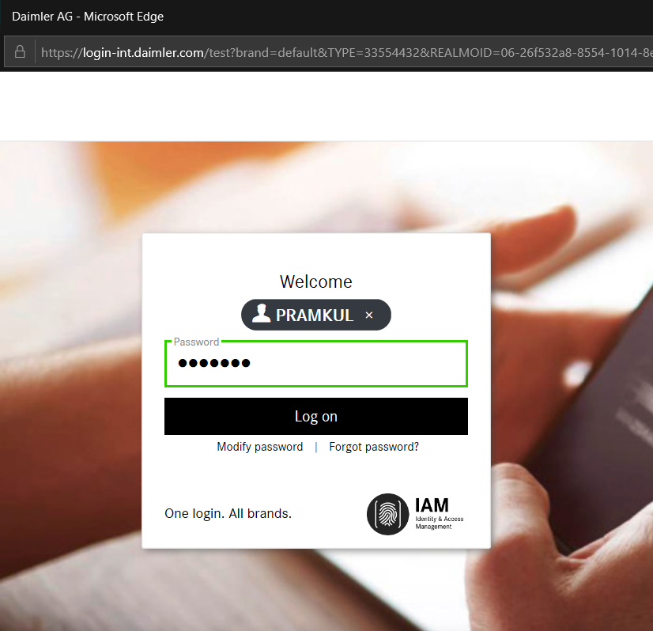
Initiation
Enter valid user name and password and Click on Log on button
Enter the Login credentials
Click on Log on

Slide 6
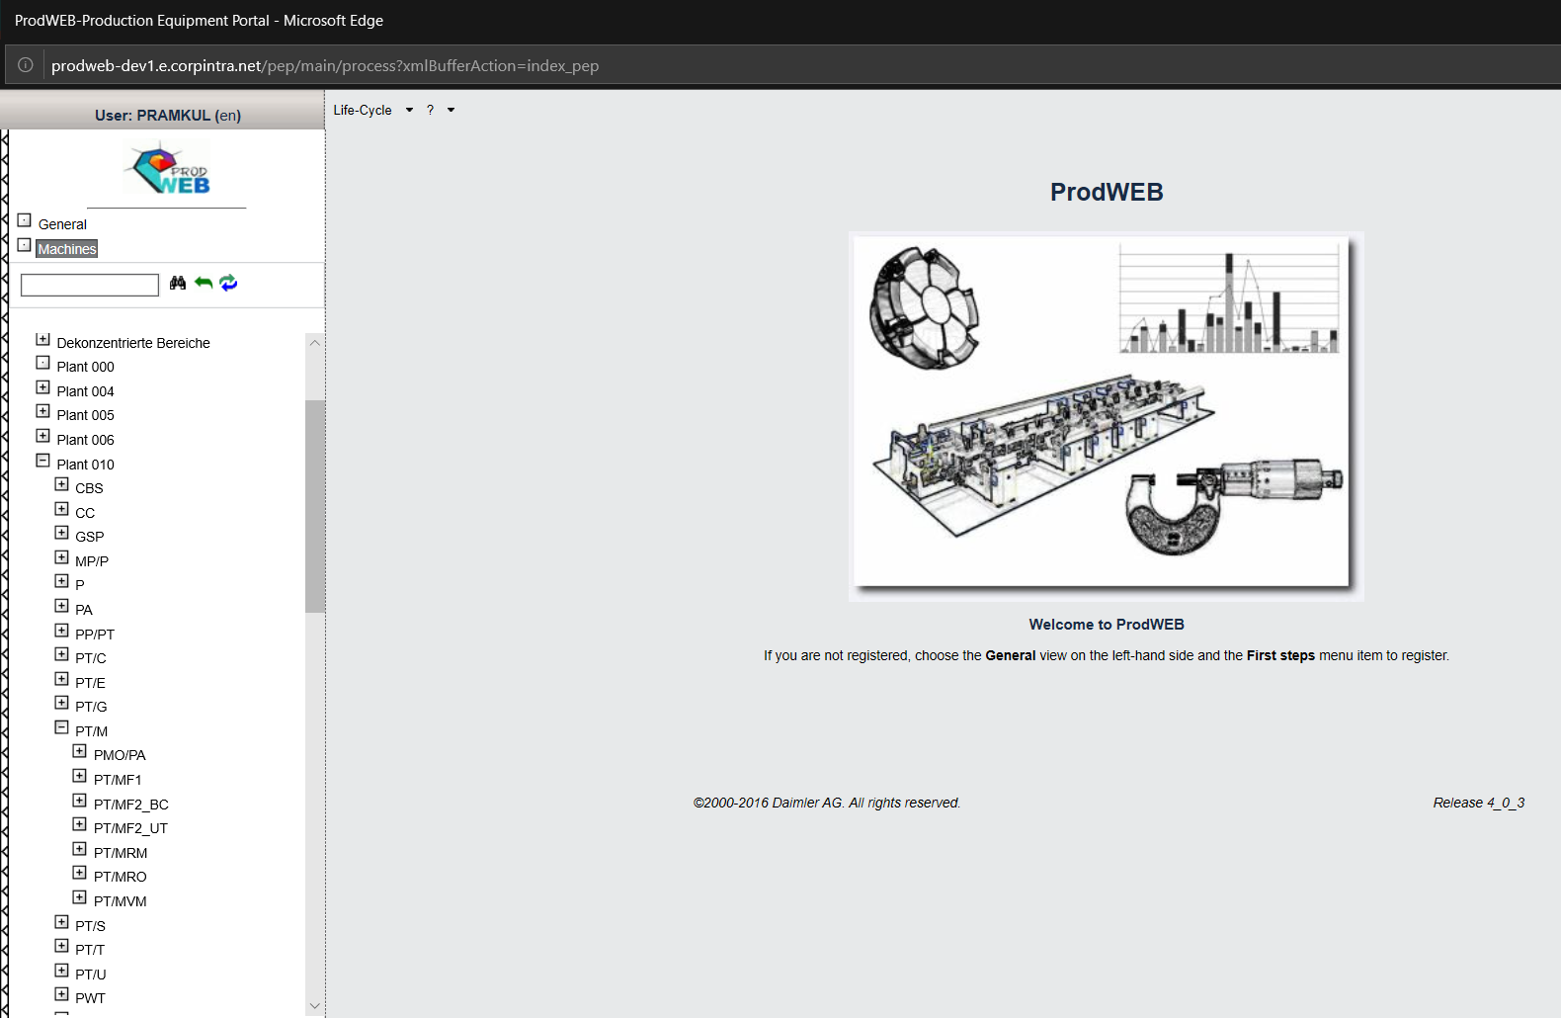
Home Page-Prod web tree
On Click of login button Prodweb page is displayed.
PLA user can select respective Plants and Cost center and access the PLA application
Plant 10 points to Plant Untertürkheim
To select particular node navigate from Machines->Plant 10 →Production Engines[PT/M] → PT/MVM
PT/M Consists of Production Engine information
All Engine Component Manufacturing information is present in node PT/MF2_UT

Slide 7
Content
System Tutorial

Slide 8
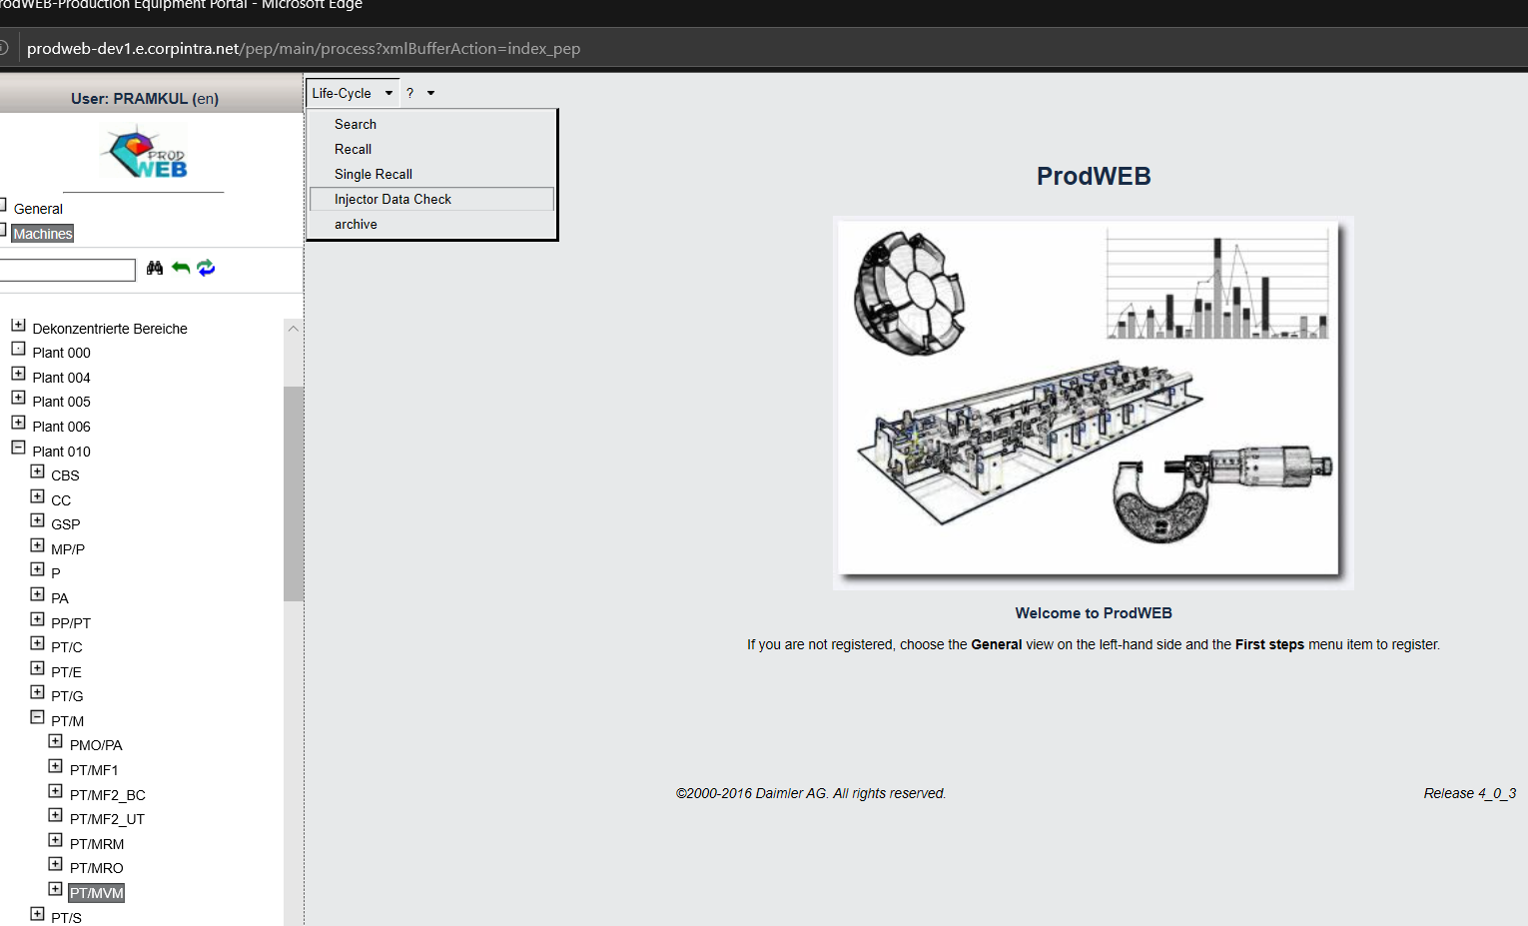
System Tutorial Navigation
PLA-User can access any module based on the rights assigned to each user. On Click of search module Search page will be displayed
Life Cycle Menu bar Consists of 5 modules. Search, Recall, Single Recall, Injector data check and archive
MBRDI is only responsible for Search, Recall, Single recall and Injector Data check. Archive is not in the scope of MBRDI.

Slide 9
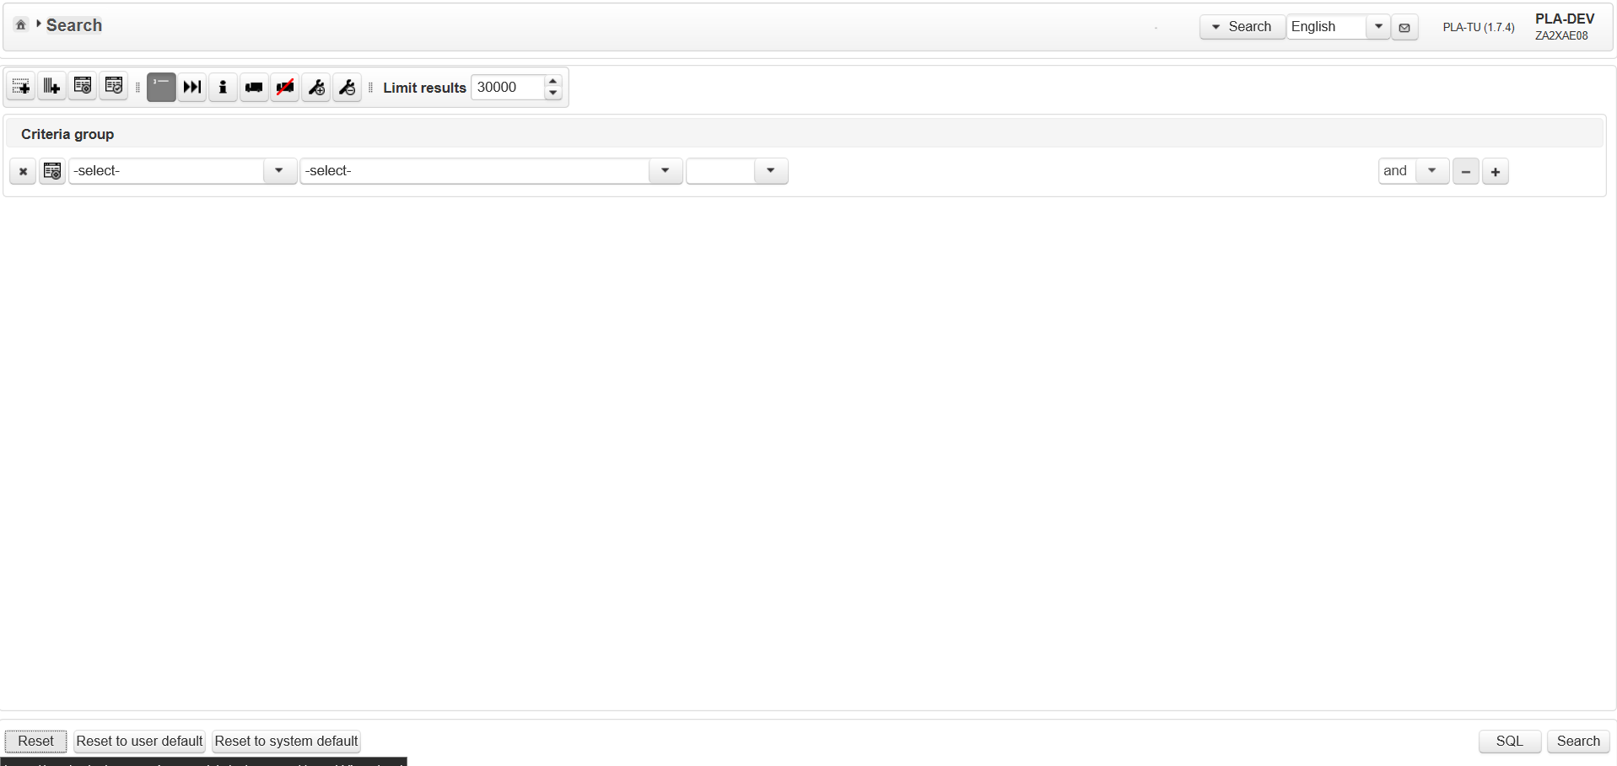
Search Screen
Search is one the important module of PLA. It's purpose is to provide a simple, easy-to-use interface to the user, so that he can build complex search statements without any SQL-knowledge.

Slide 10
Search View :
PLA-User / PLA-RecallUser has a very flexible interface at hand to choose from a wide variety of input fields (search criteria's) and to build very complex search statements without any SQL knowledge.

Slide 11
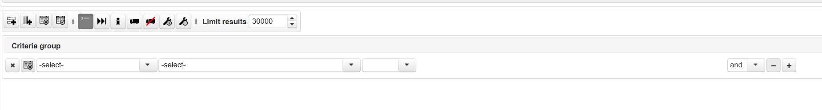
Search Criteria's
The search criteria's are arranged in groups, according to the logical entities in the current application.
The first select-box is used to switch between these groups. The available groups are ordered by the localized labels.
Second drop down should populate the list corresponding to the selected value in first drop down.The groups/input fields and the corresponding tables/table columns will be defined in a configuration table.
Third drop down (Operator ) will display the list of operator applicable for value provided in second drop down. Default operator value selected is "="
*Text box should get displayed.
Logical Conjuction drop down between criteria should remain in disabled mode.
* Delete icon should not be visible in default group.
*"-" icon should be in disabled mode on first row

Slide 12
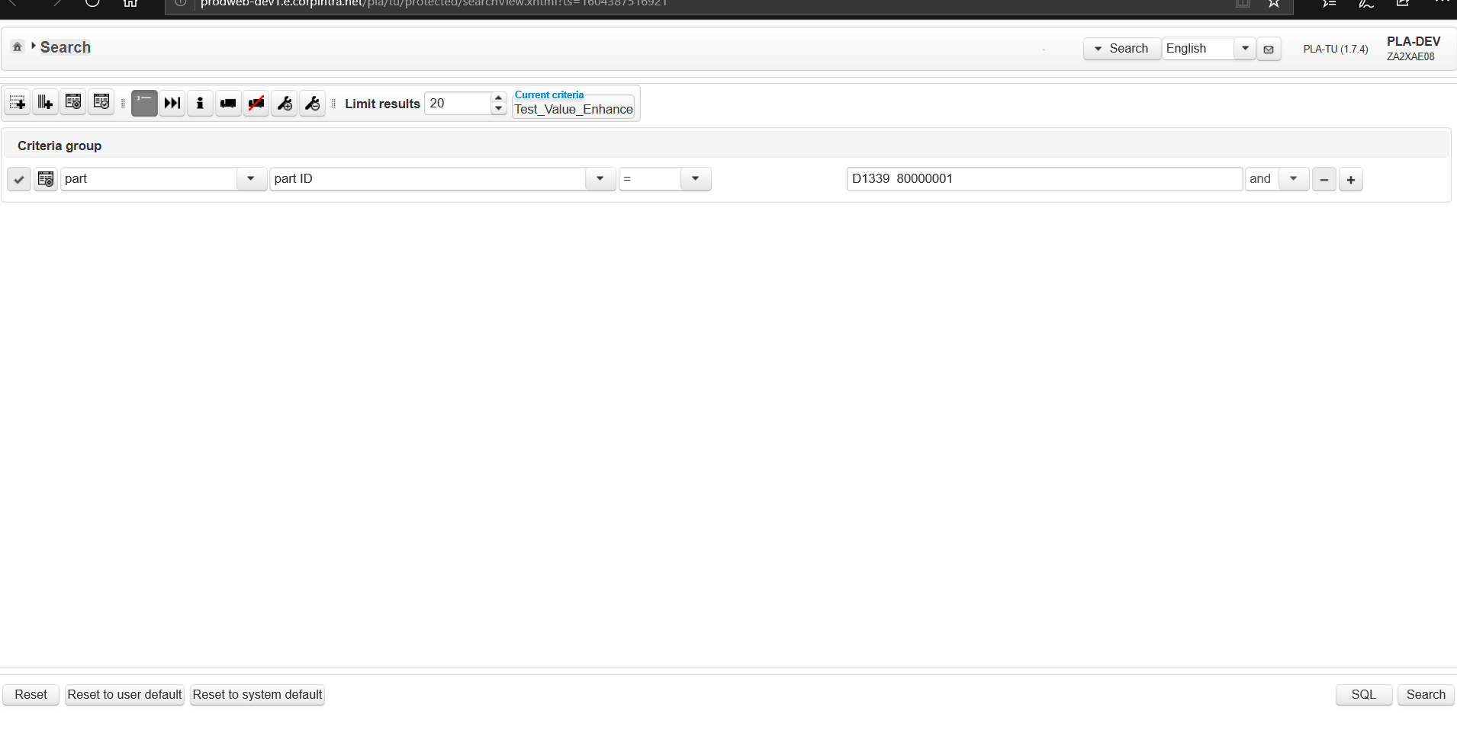
Search Criteria's
Part as primary criteria
Part ID as secondary criteria
“ = “ as operator
This is the search criteria to be searched
By default “and” is the default logical operator and “-” minus button is for delete and “+” plus button to add criterias
Click on Search button

Slide 13
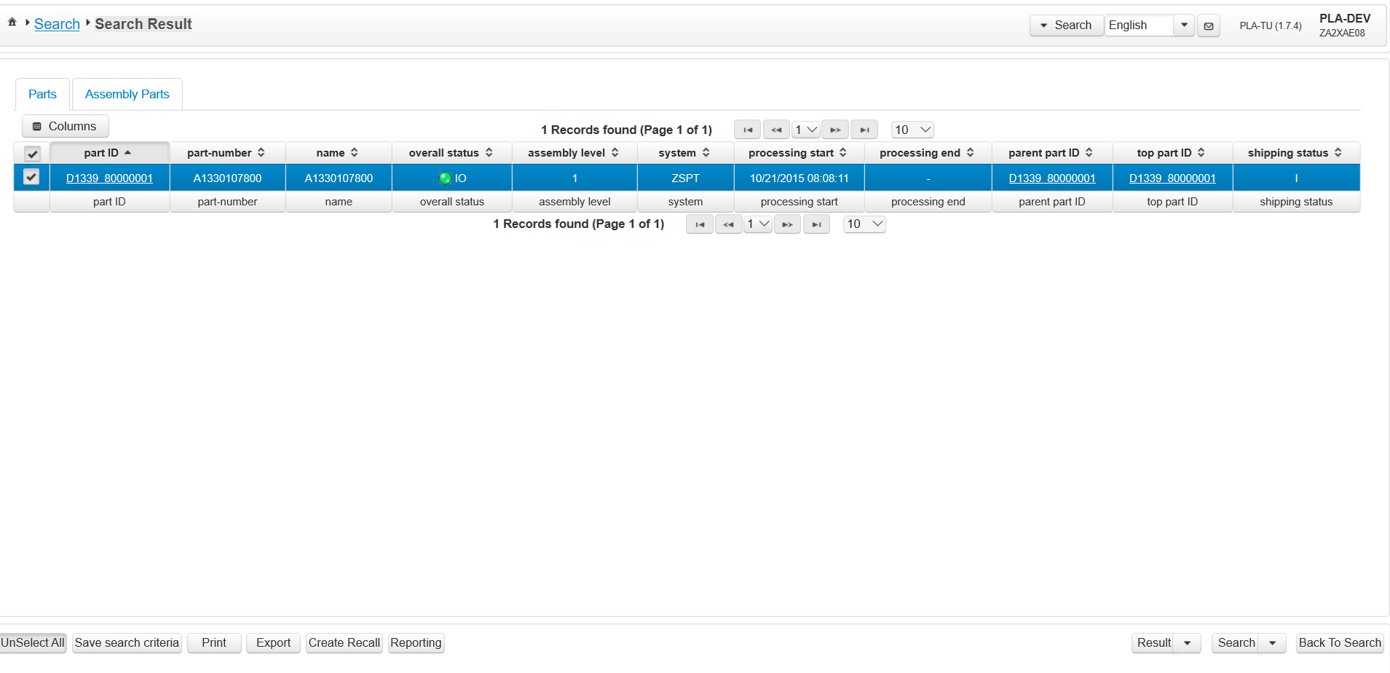
On Click of Search button
On click of Search button Search result page is displayed
By Default parts tab is displayed
Part D1339 80000001 is searched on DB table ST_TEIL_V view when search criteria matches results are displayed
Search result table consist of default columns those column should be displayed by default
Click on back to search

Slide 14
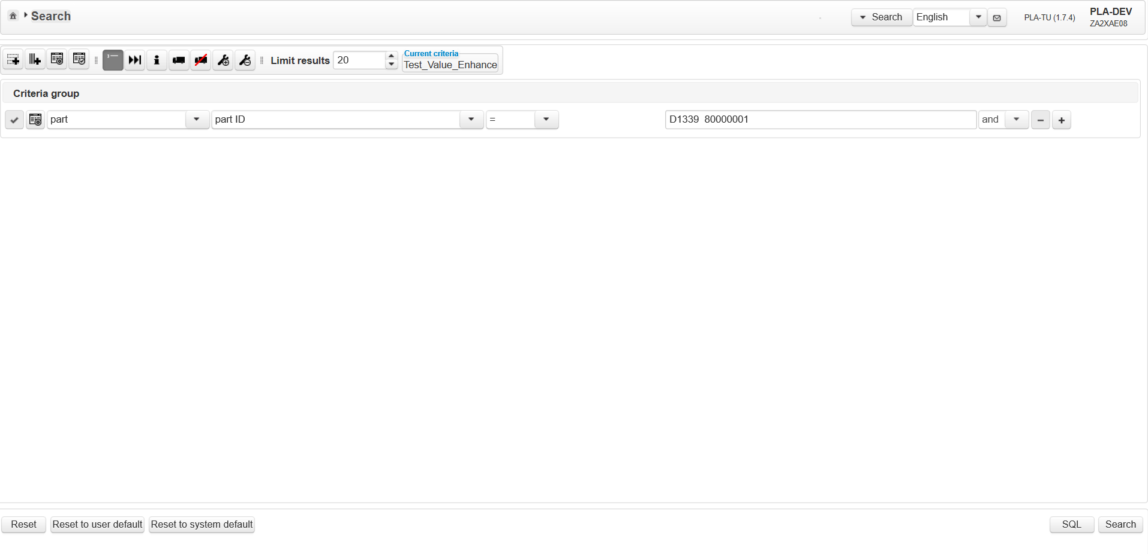
On Click of Back to Search in Search Result page
On Click of back to search, previously Searched is maintained and is not cleared. You can alter same criteria's or add new criterias and perform search button

Slide 15
On Click of Back to Search in Search Result page
On Click of back to search, previously Searched criteria's is maintained and is not cleared. You can alter same criteria's or add new criteria's and perform search button

Slide 16
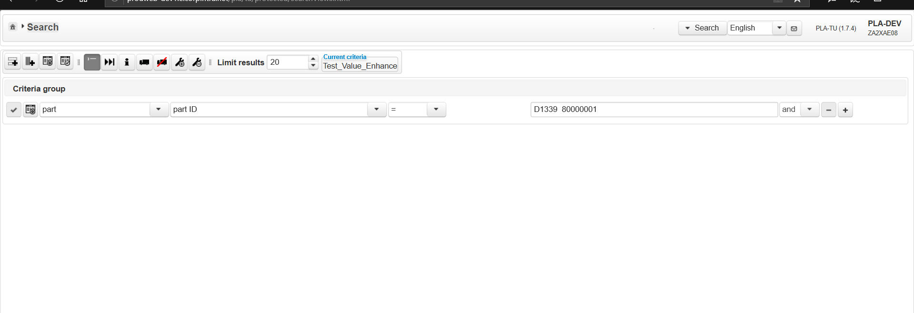
Validate top level buttons
Additionally to the search criteria given on the search input several actions/settings can be taken/done by PLA-User / PLA-RecallUser, using the buttonbar on top of the search view.
Buttons are described in the order they should appear on the button bar.

Slide 17
Validate top level buttons
Additionally to the search criteria given on the search input several actions/settings can be taken/done by PLA-User / PLA-RecallUser, using the buttonbar on top of the search view.
Buttons are described in the order they should appear on the button bar.

Slide 18
Click on New Criteria group
Click on New Criteria group

Slide 19
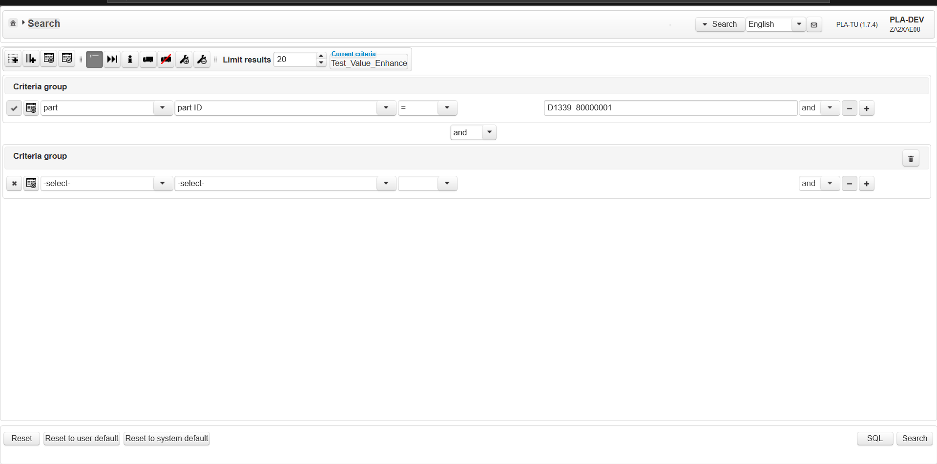
Click on New Criteria group
Logical conjugation between criteria's by default “ and “ is displayed
Delete button should be displayed for new criteria group
A new group should get inserted
And logical Conjunction between group should appear by default its “and”

Slide 20
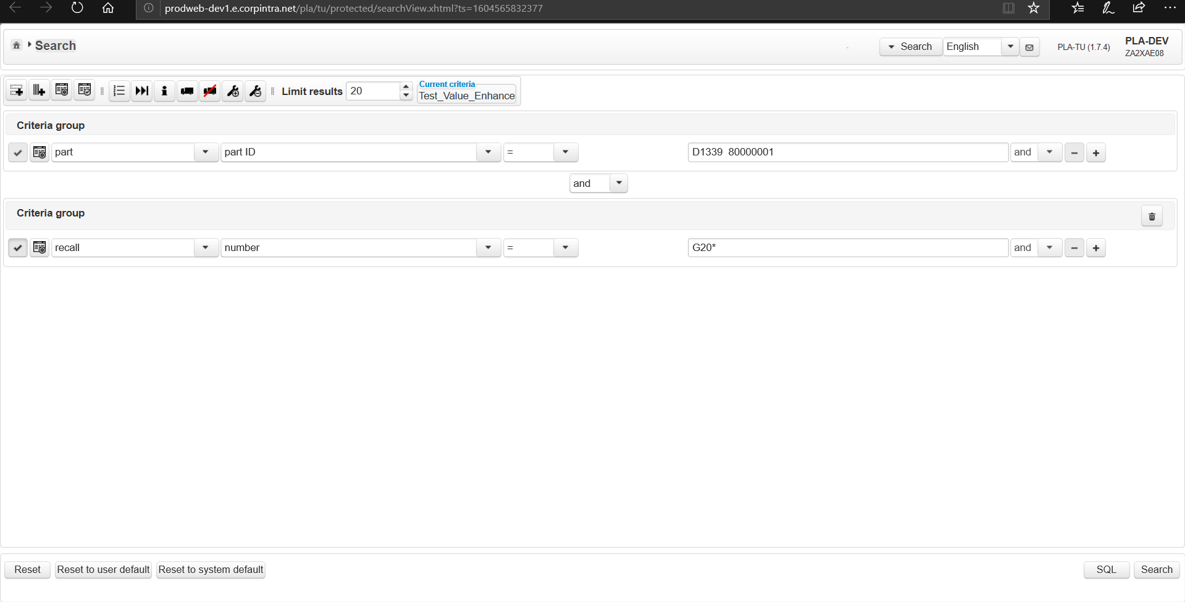
Click on New Criteria group
Set criteria for new criteria group ,and conjugate with “ and “ operator and Click on Search button
Click on Search button

Slide 21
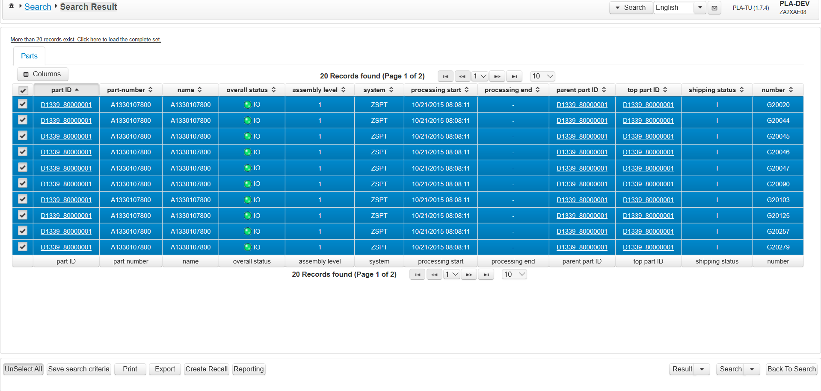
On Click of Search button
As its AND operation Search result matching both the criteria's are displayed.
Number(recall number) which is displayed as additional column along with default columns

Slide 22
Click on back to search button
Click on back to search button/click on home button present at top left of the screen

Slide 23
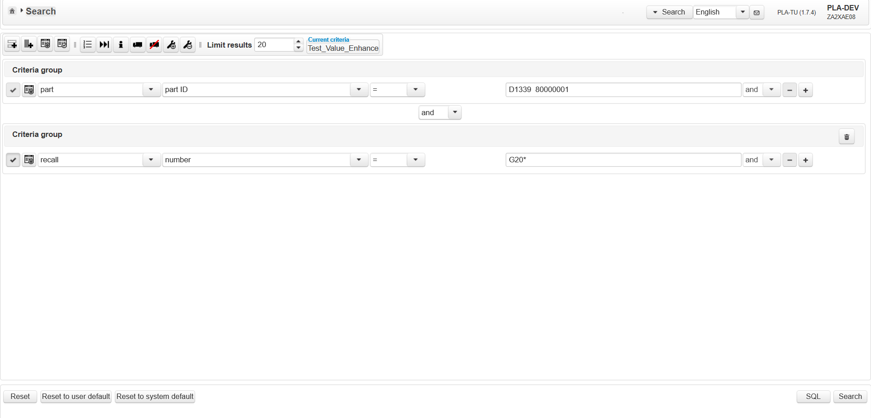
Click on Delete criteria group button
Click on delete button

Slide 24
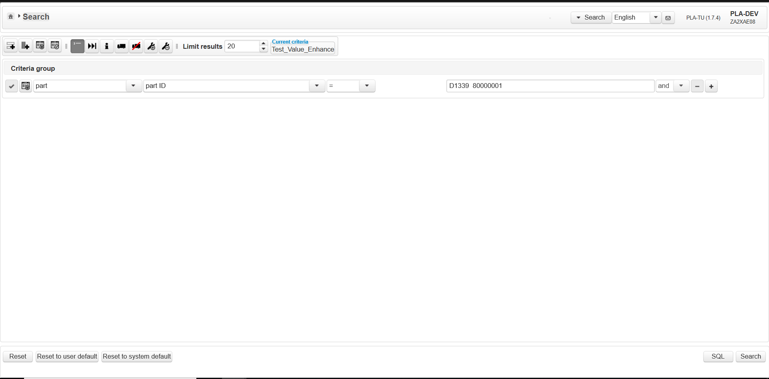
On Click Delete criteria group button
On Click of delete button Criteria group is deleted

Slide 25
Click on Additional columns button
Click on Additional columns button

Slide 26
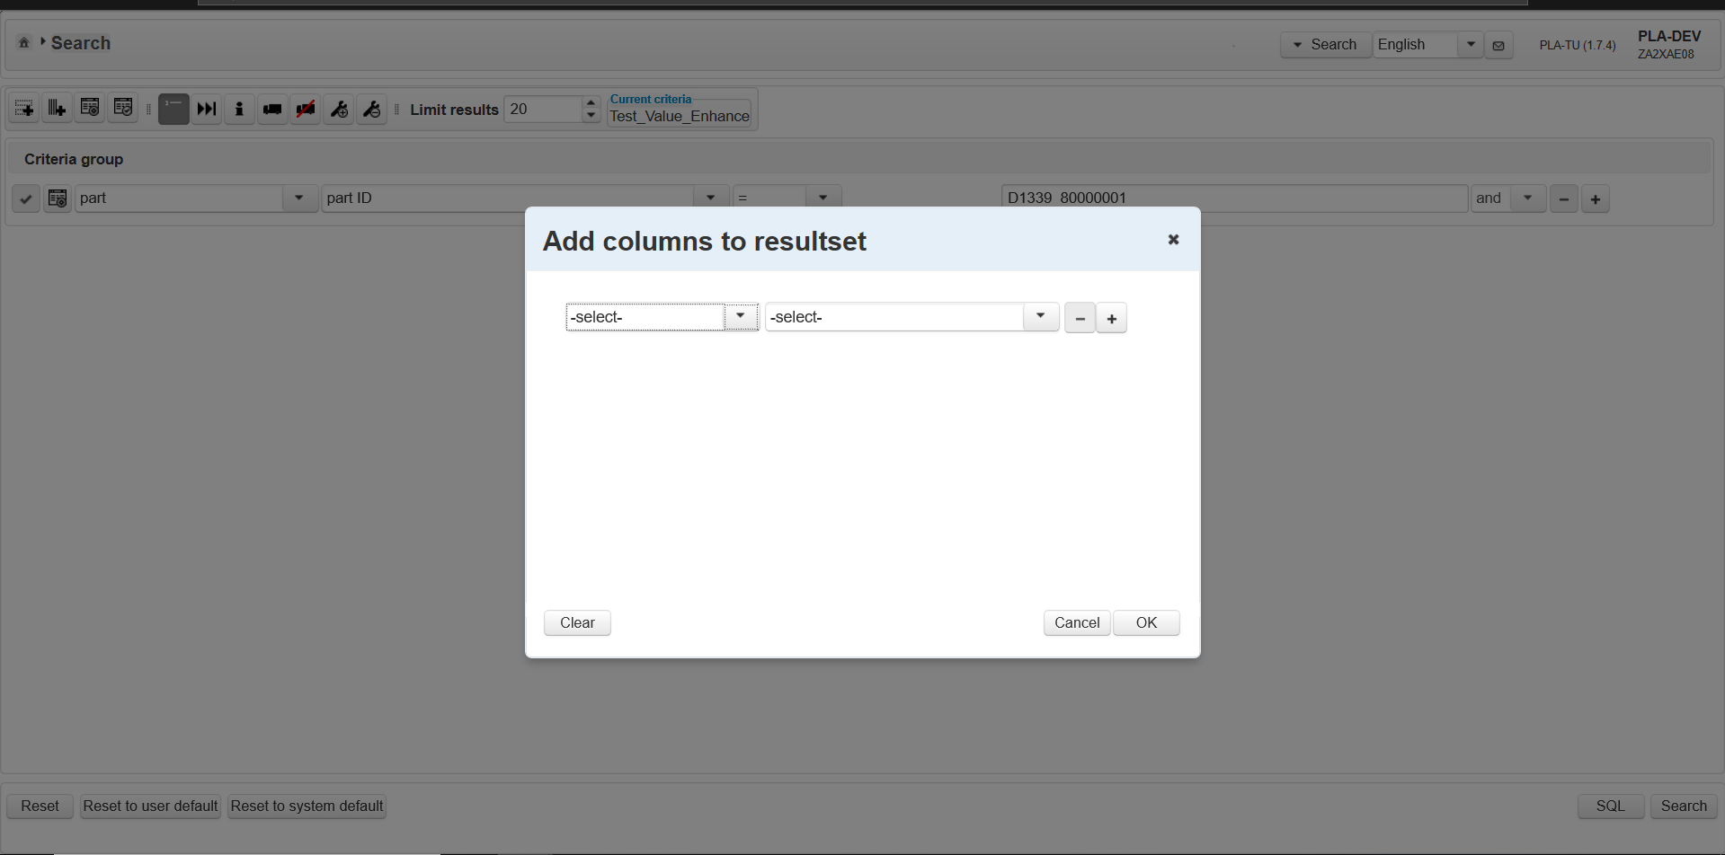
On Click Delete criteria group button
Additional column dialog is displayed. By default dropdowns are displayed as “ –select-”
It consists of three button clear, cancel and OK buttons

Slide 27
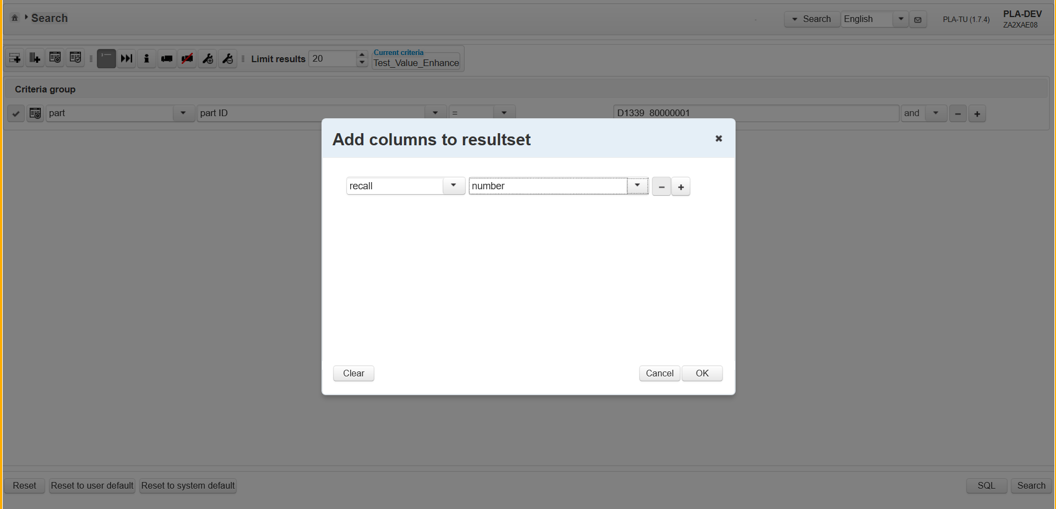
Set criteria and Click OK button
Set criteria recall→ number
Click OK button

Slide 28
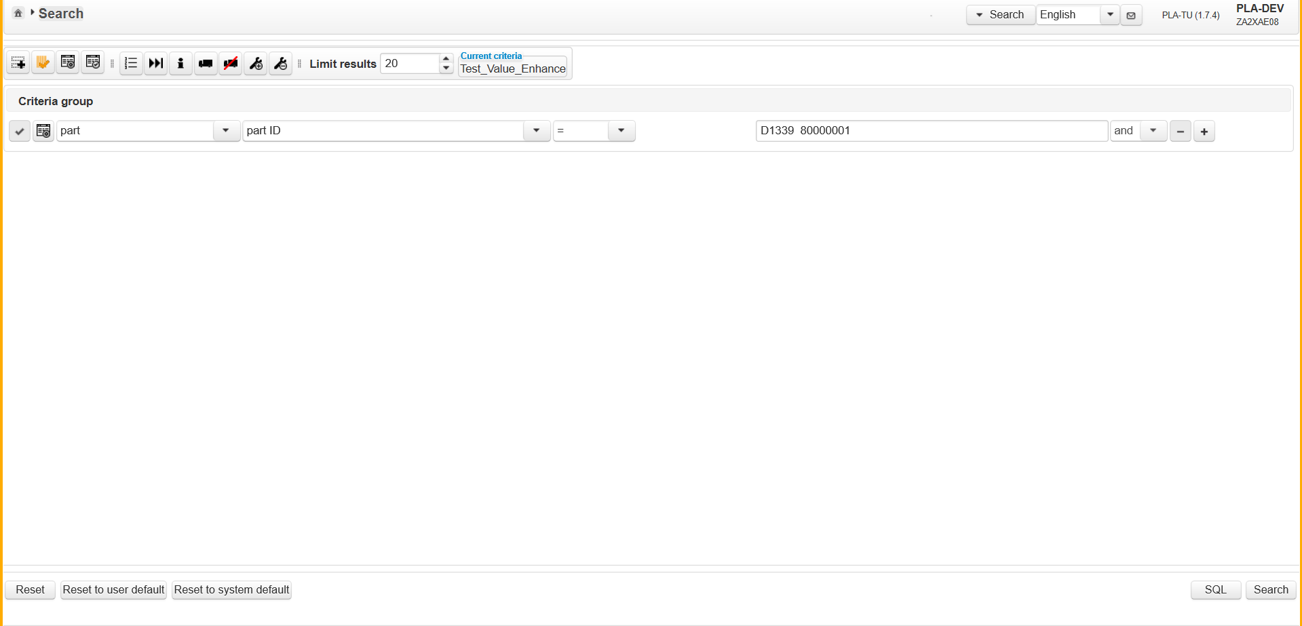
Click Search button again for additional column criterias
On adding additional column, color turns to Orange with checked icon is displayed, indicates additional column is added.
Click Search button again

Slide 29

Search Result page
On Search view limit is set to 20 so only 20 parts are displayed.
Recall Number is displayed as additional column. All the recall numbers are displayed for the part “D1339 80000001” which are added to recall during recall creation

Slide 30
Click on Search breadcrumb
Click on Search breadcrumb

Slide 31
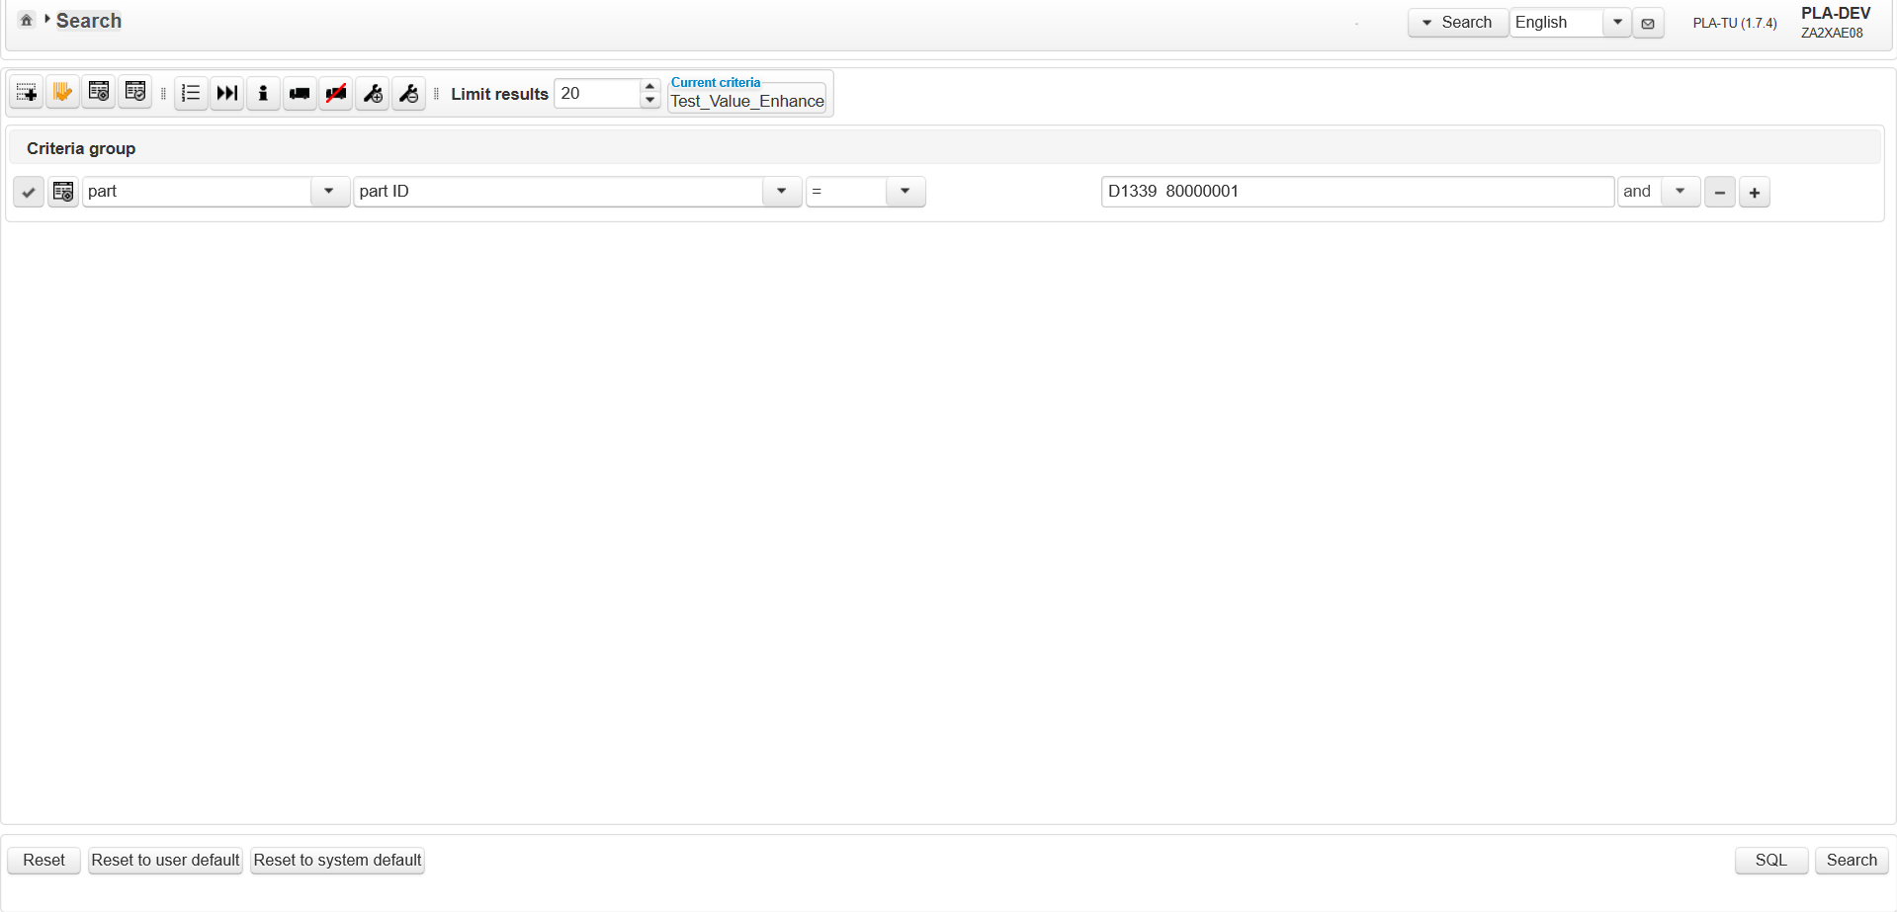
On Click of Search breadcrumb
Search view is displayed and previous session is maintained.

Slide 32
Click on reset button
Click on Reset button

Slide 33
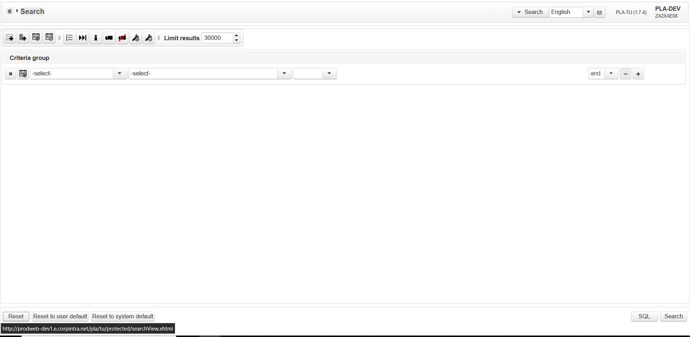
On Click of reset button
Criteria's are cleared and by default “ –select-” is displayed for first two dropdowns

Slide 34
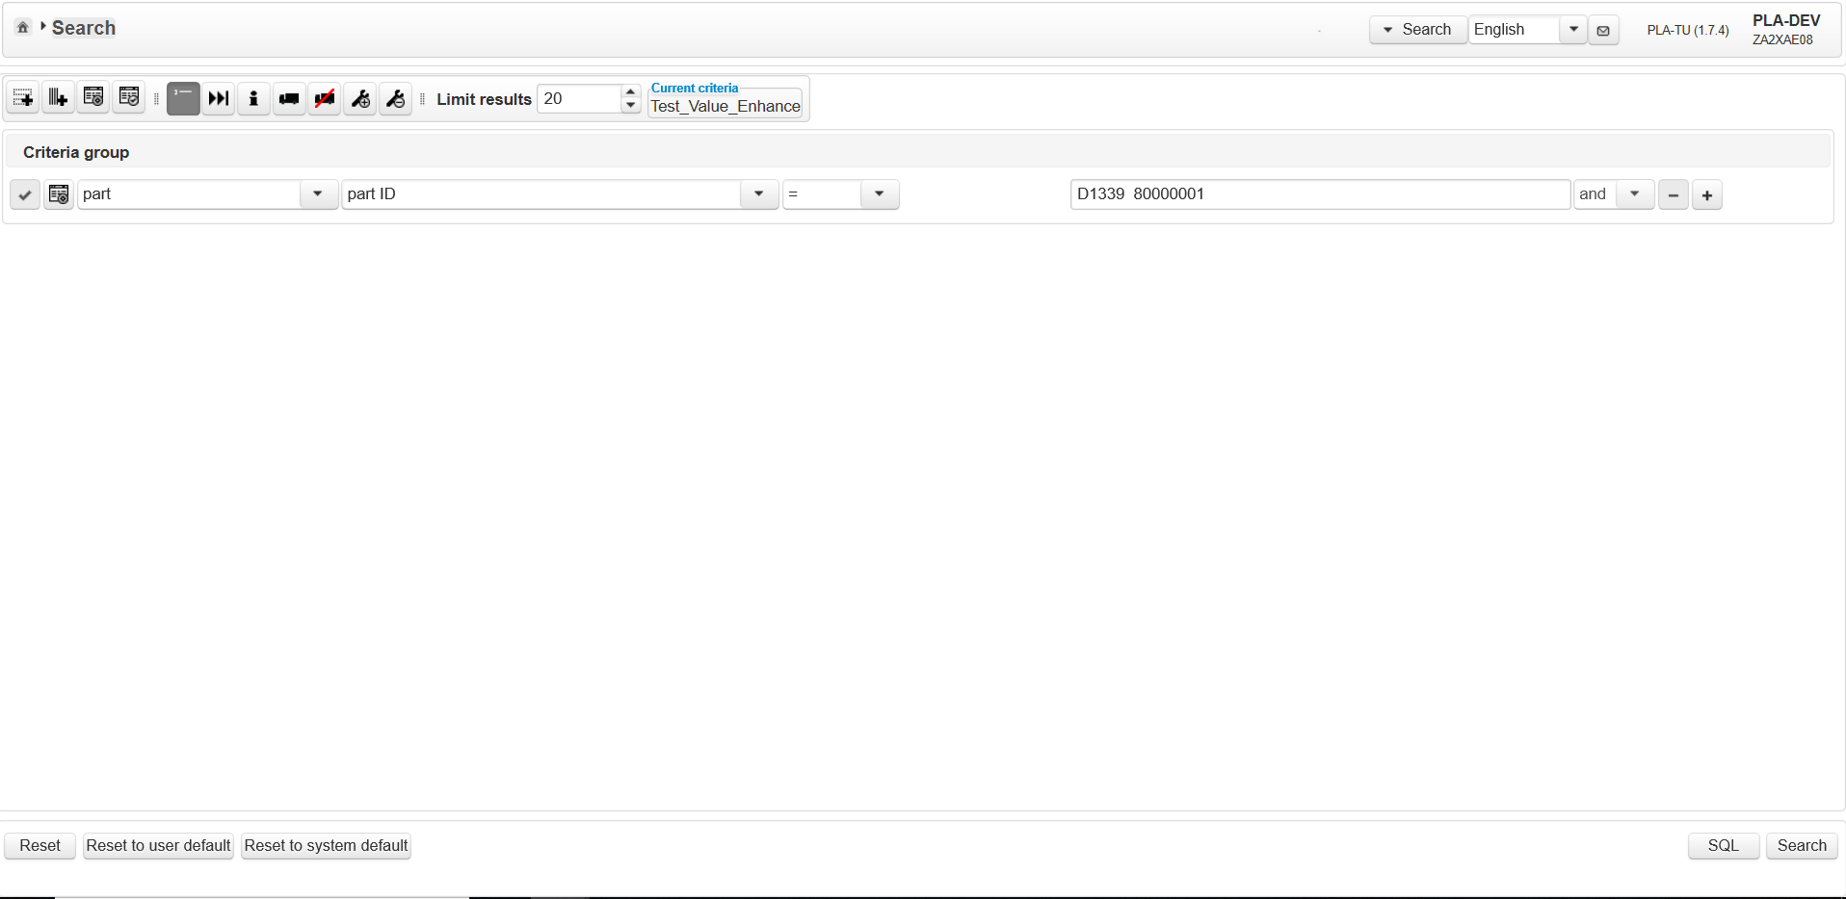
Set Criteria and Click save button
Click on save criteria button

Slide 35
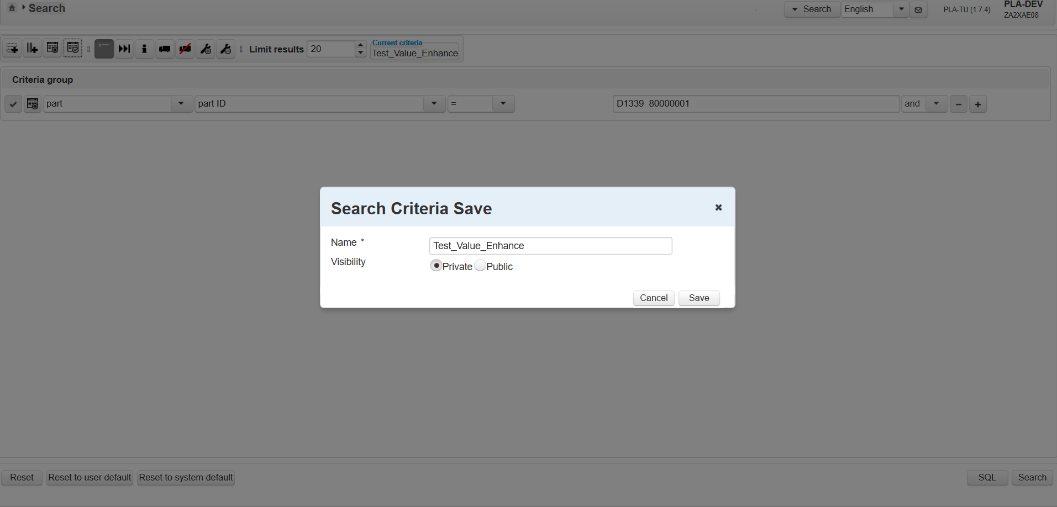
Set Criteria and Click save button
Save Criteria dialog give options to enter the criteria name with Visibility option either public or private

Slide 36
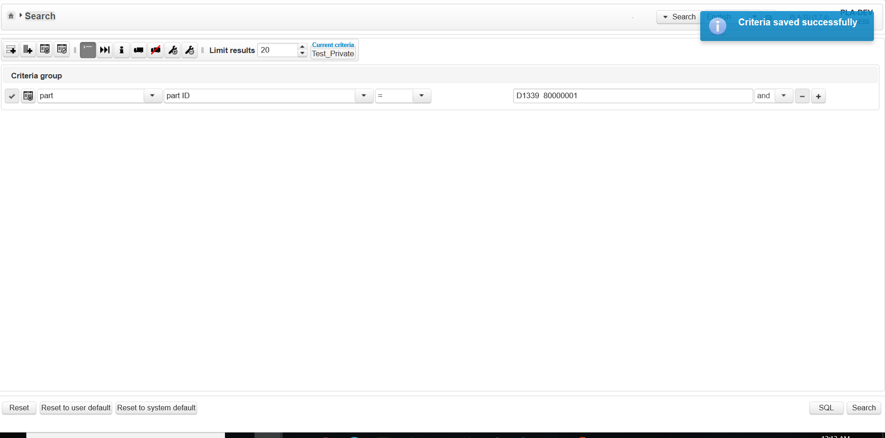
Enter Criteria name and Click save button
Criteria saved successfully message should be displayed
Click on Search Criteria Management dialog

Slide 37
Enter Criteria name and Click save button
Click on Search Criteria Management dialog

Slide 38
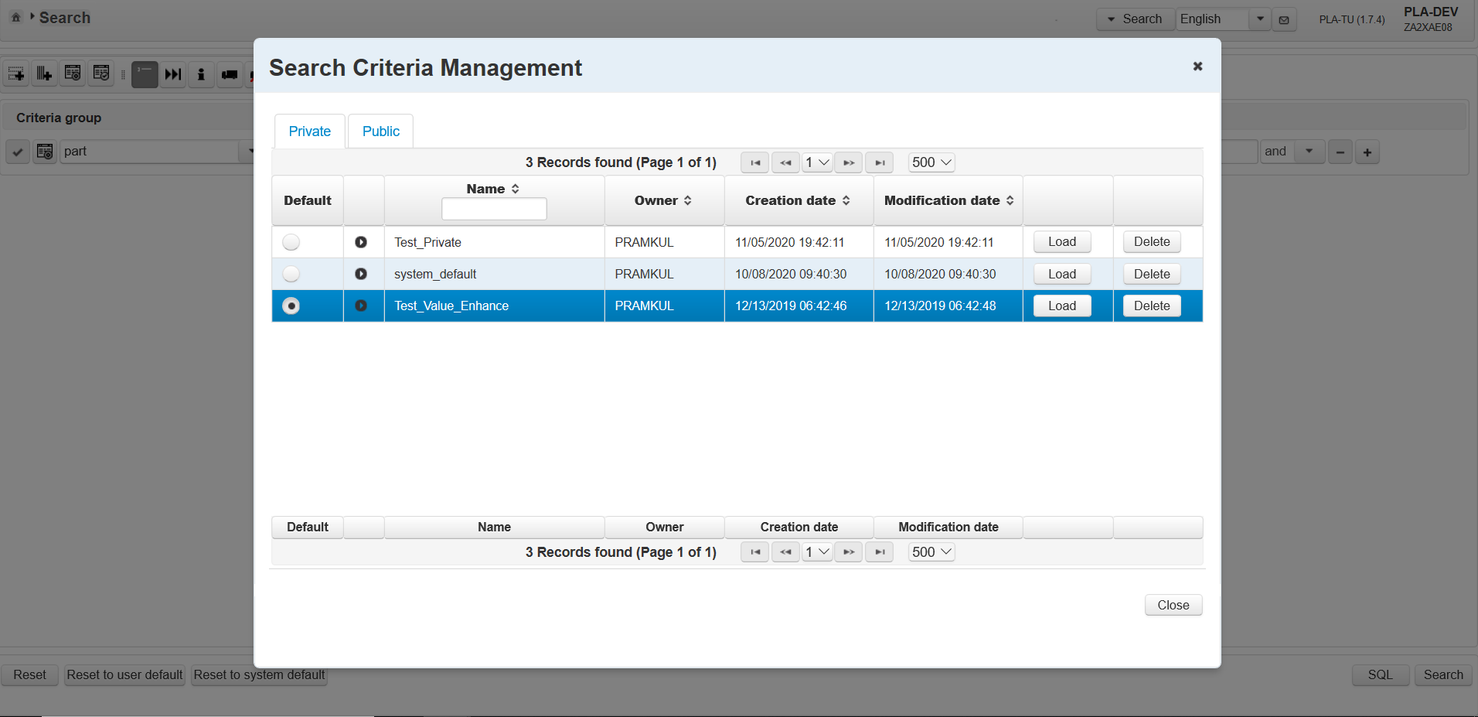
On Click of Search Criteria Management
By Default Private tab is displayed.
Criteria Test_Private is displayed in Private tab with Owner name. Private criterias can be seen to only to logged in user

Slide 39
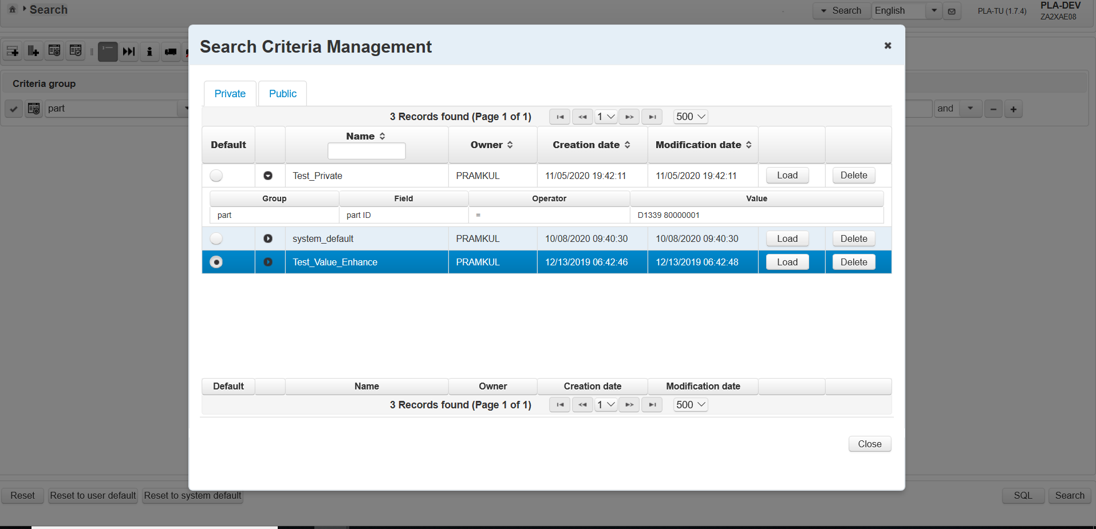
Expand the accordion
On Click on this accordion is expanded and criteria's which are saved can be seen here
Criteria Test_Private is displayed in Private tab with Owner name. Private criterias can be seen to only to logged in user

Slide 40
Default criterias
Make it Test_Private as default criteria by selecting radio button
This is the default criteria now. Radio button is selected in blue color and whole row is highlighted in blue color

Slide 41
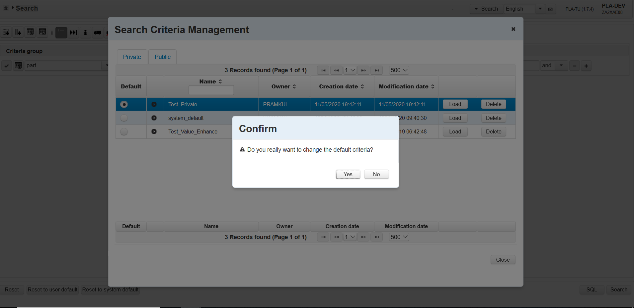
Change Default criterias and Click Yes button
On Click of radio button Test_Private Confirmation dialog is displayed
Click on Yes button
On Click of Yes button default criteria will be changed and on Click of no button Confirmation dialog will be closed

Slide 42
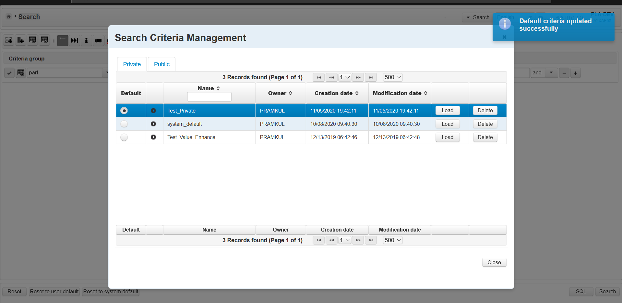
Change of Default criteria's and Click Yes button
Growl message will be displayed and in DB it will be updated
Each Criteria consist of Load and Delete button. Delete button only visible if you are owner of that criteria

Slide 43
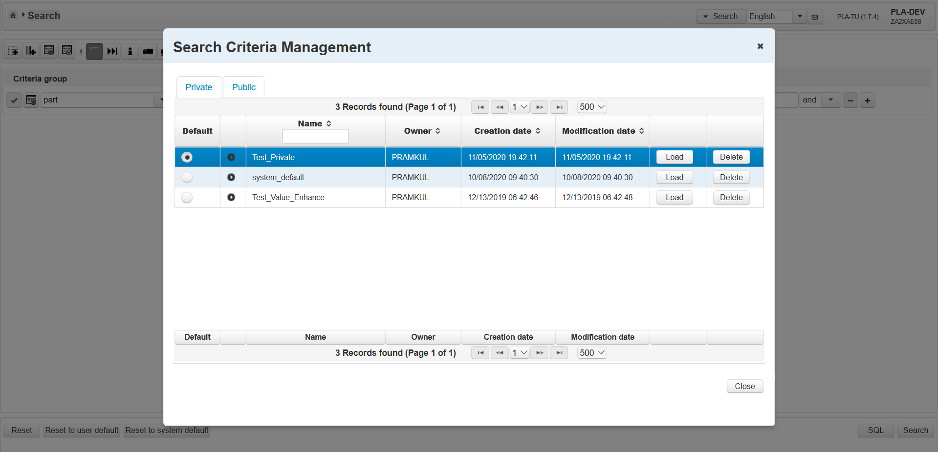
Click Delete button
Click on Delete button for 2nd row system_default criteria

Slide 44
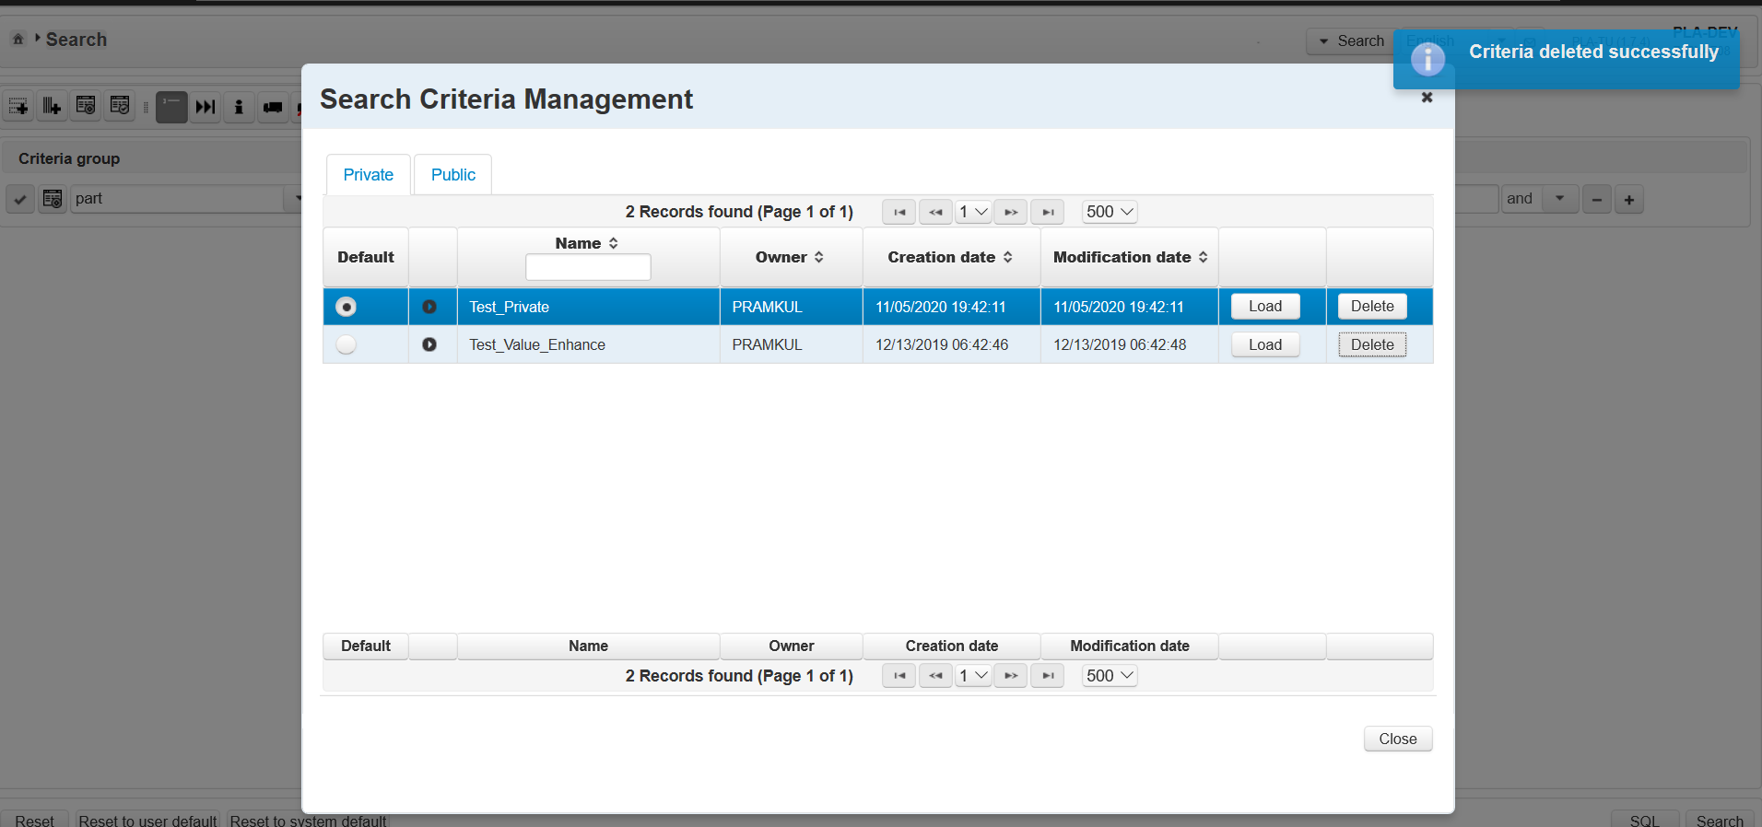
Click Load button for Test_Value_Enhance criteria
Click on Load button

Slide 45
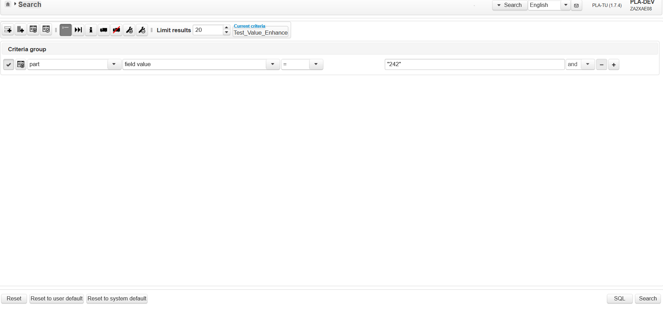
Click Load button for Test_Value_Enhance criteria
Criteria name should be updated
On Click of Load button ,Search view will be displayed and criteria which is saved will be displayed

Slide 46
Click Reset to user default button
Click on Reset to user default button

Slide 47
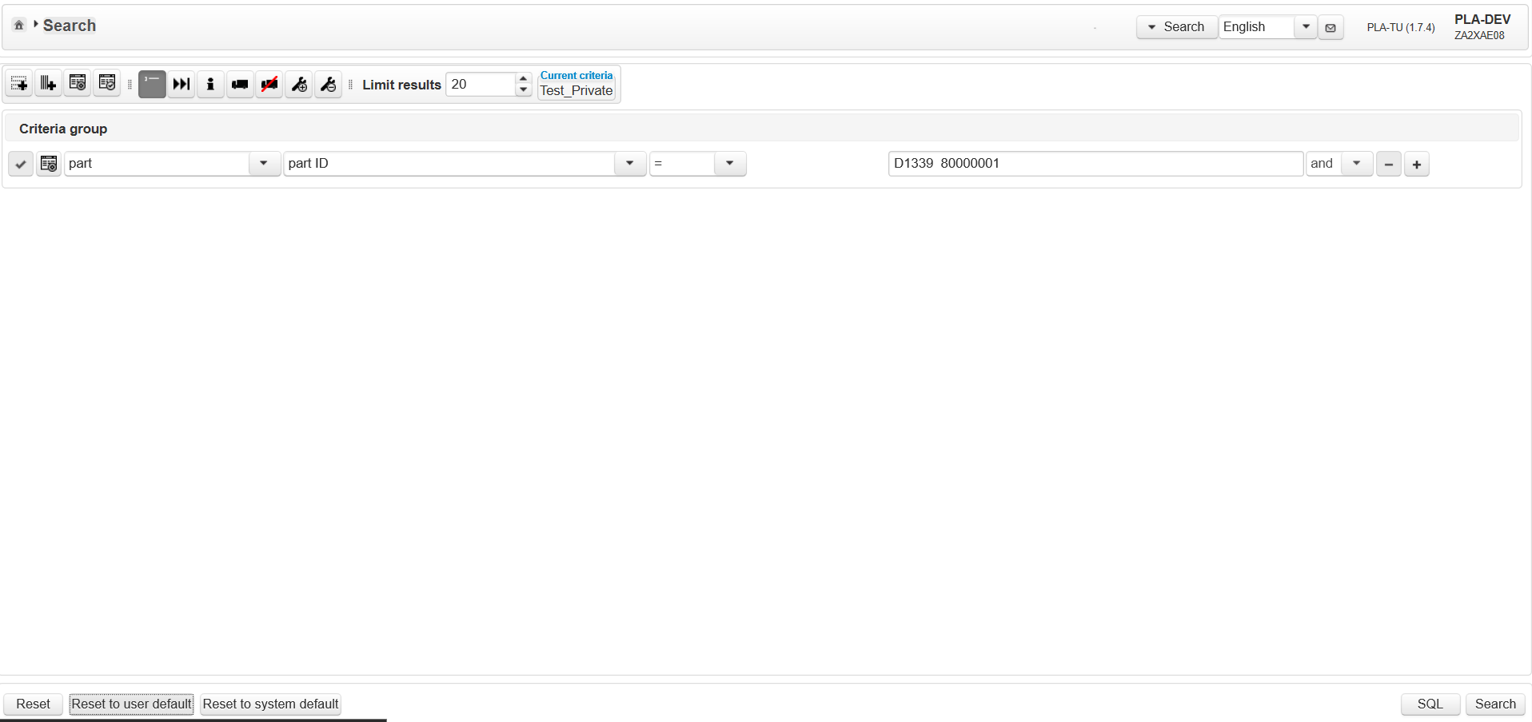
On Click of Reset to user default button
Criteria name should be updated
Default criteria's which are saved in Search Criteria Management those criteria's should be displayed

Slide 48
Click on Reset to system default button
Click on Reset to system default button

Slide 49
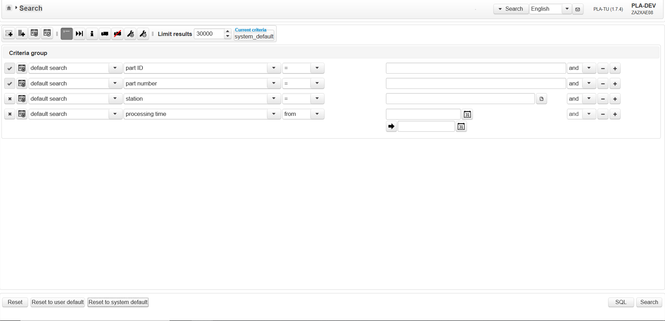
Click on Reset to system default button
Above criteria's are called default criteria's. When there are no user default criteria's , system default criteria's are displayed on landing to search view page
On Click of this calendar icon, calendar will be opened
MQTs (materialized query tables) are used in the PLA to offer a lookup even if the lookup has to be done on a very large table.

Slide 50
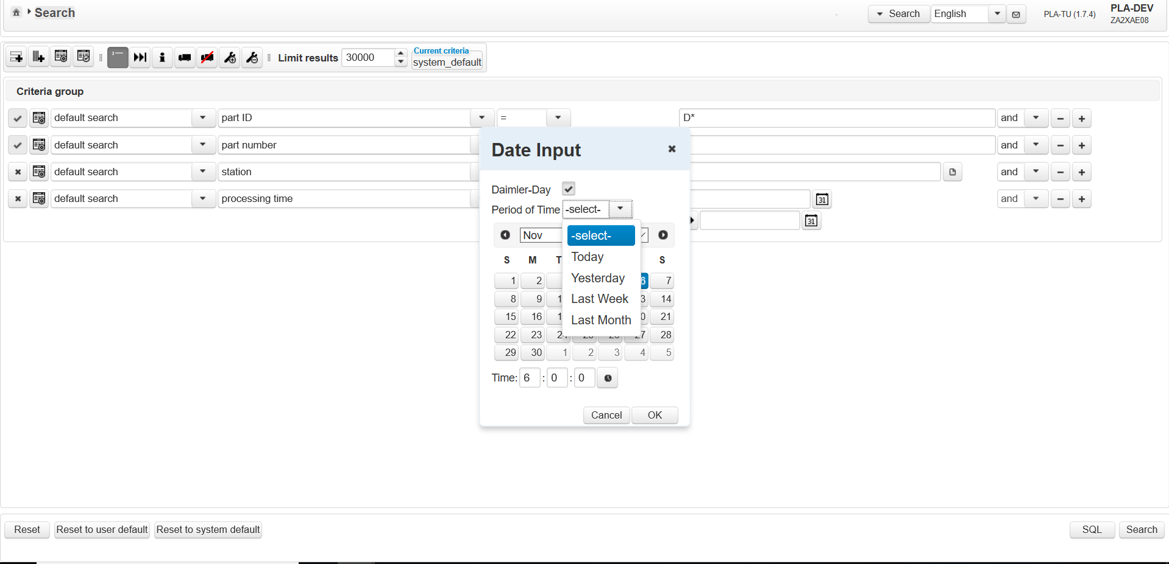
Set Criteria using Date picker
Set limit to 30000
Select Criteria as part → part ID= D*.
Select Period of time as Last Month

Slide 51
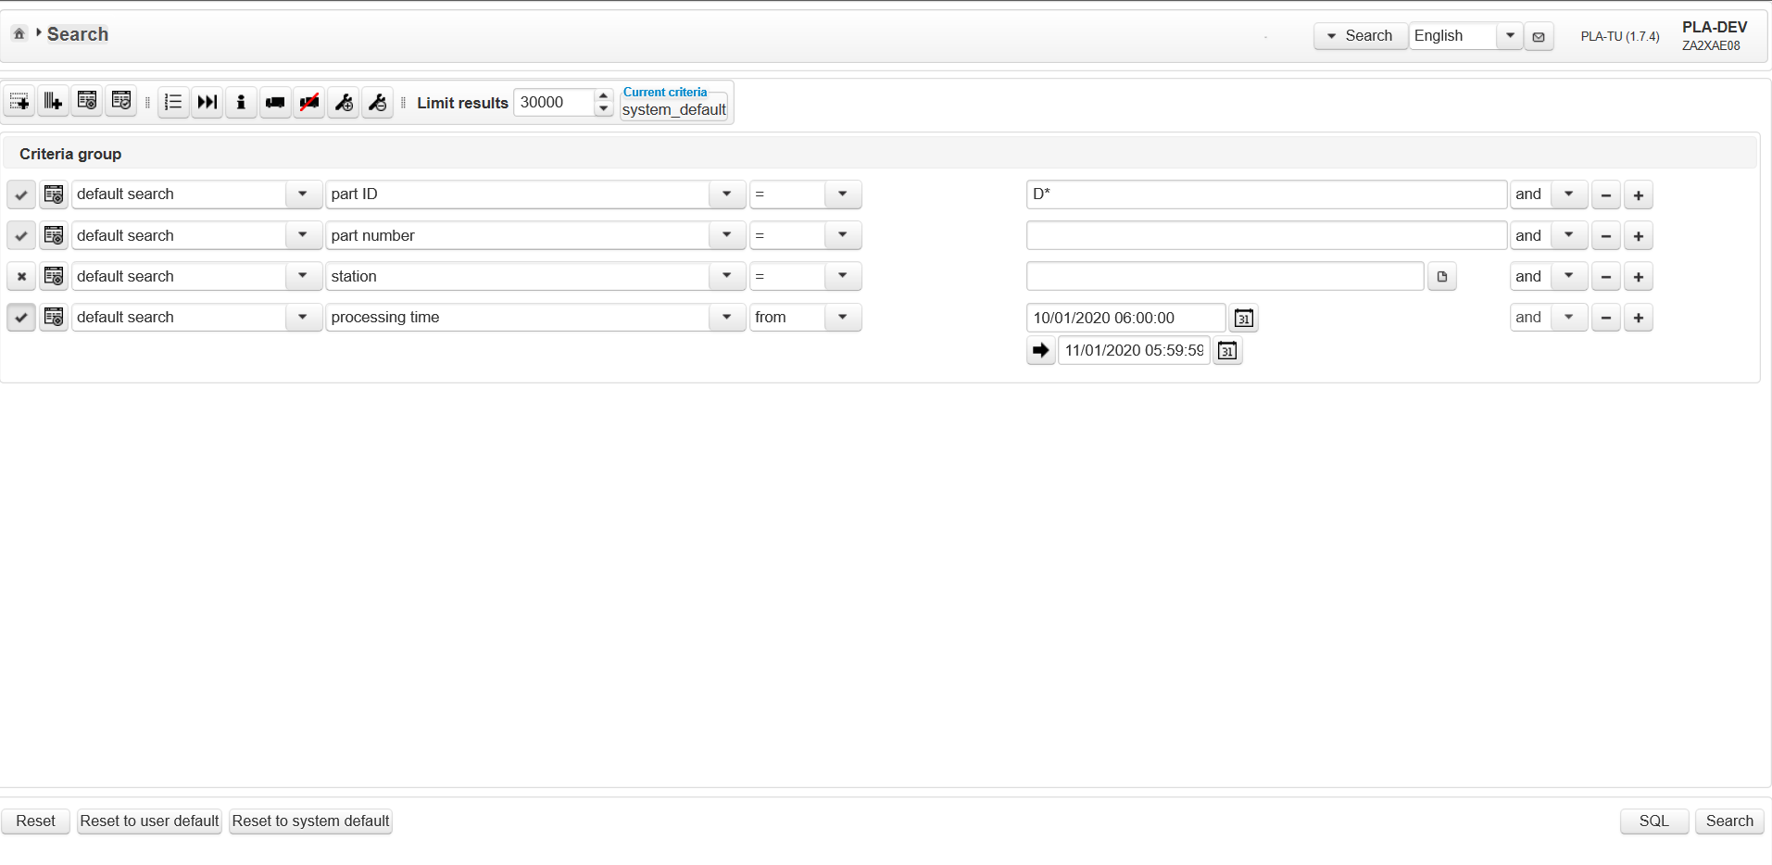
Set Criteria using Date picker
Click Search button

Slide 52
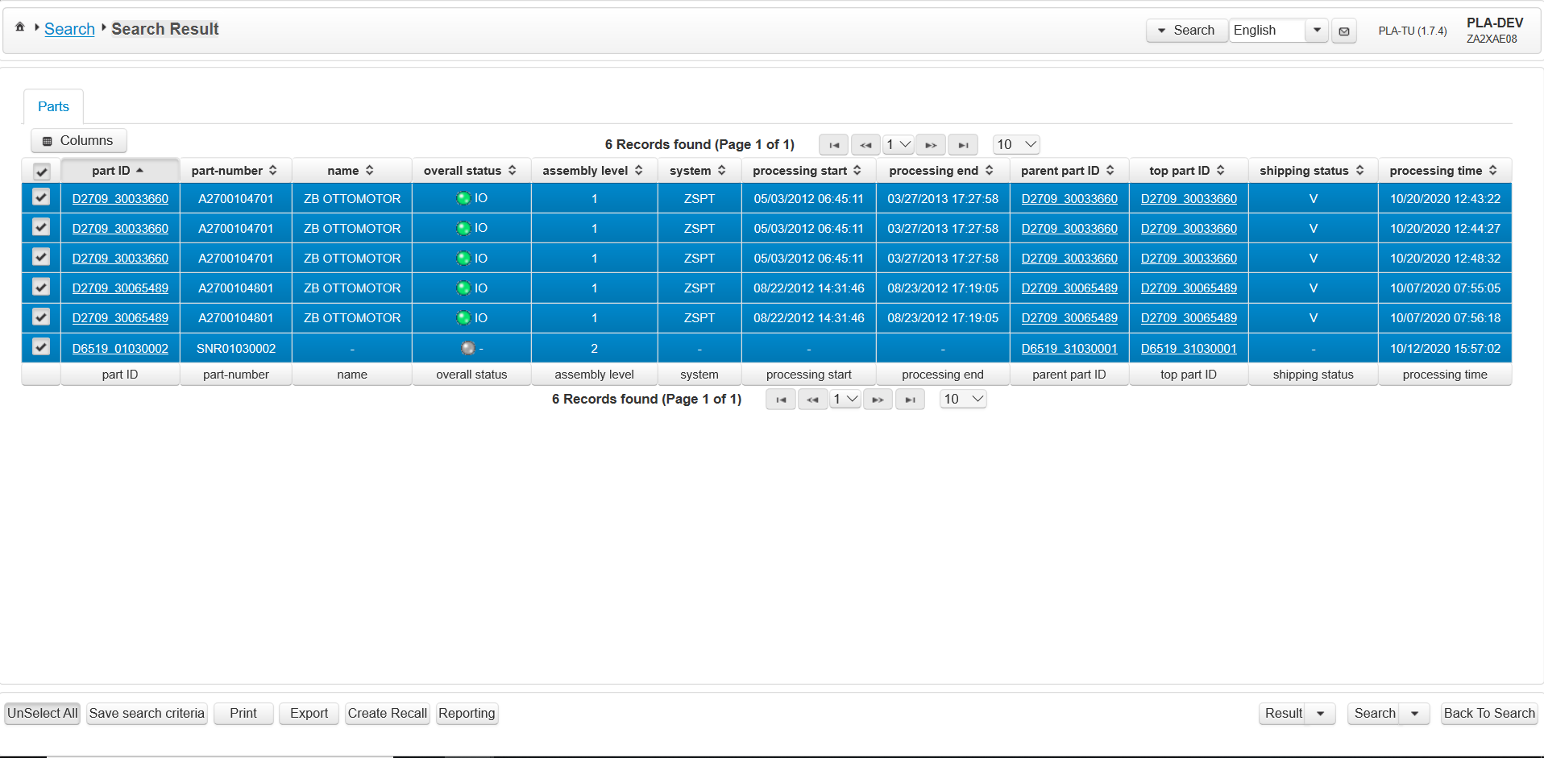
On Click of Search button
Parts which are process in the last month ,those parts are displayed in the search result

Slide 53
On Click of Search button
Parts which are process in the last month ,those parts are displayed in the search result

Slide 54
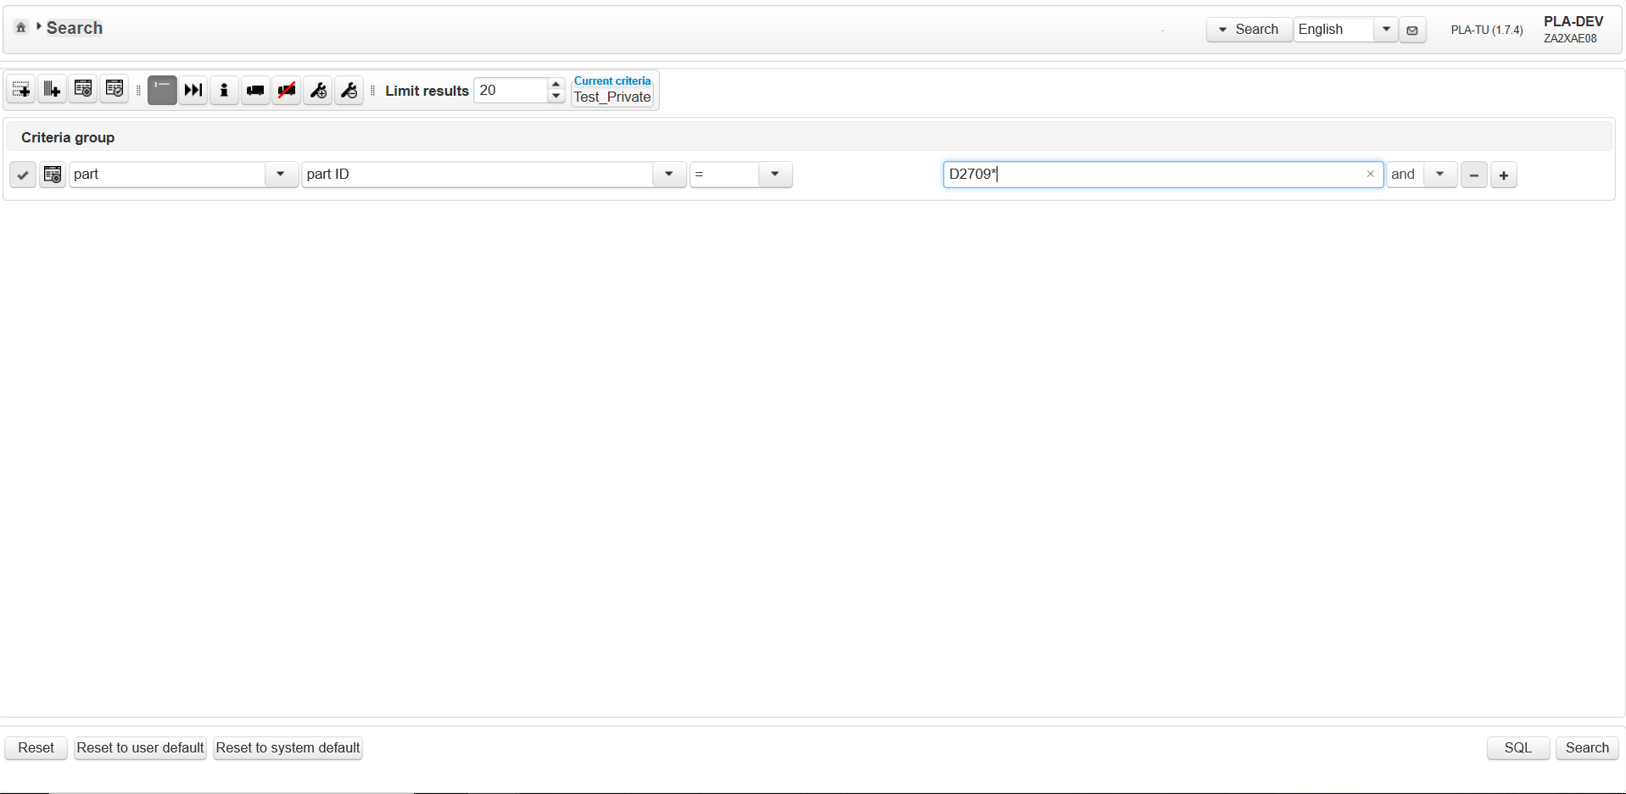
Perform show last operation
Click on show last operation button

Slide 55
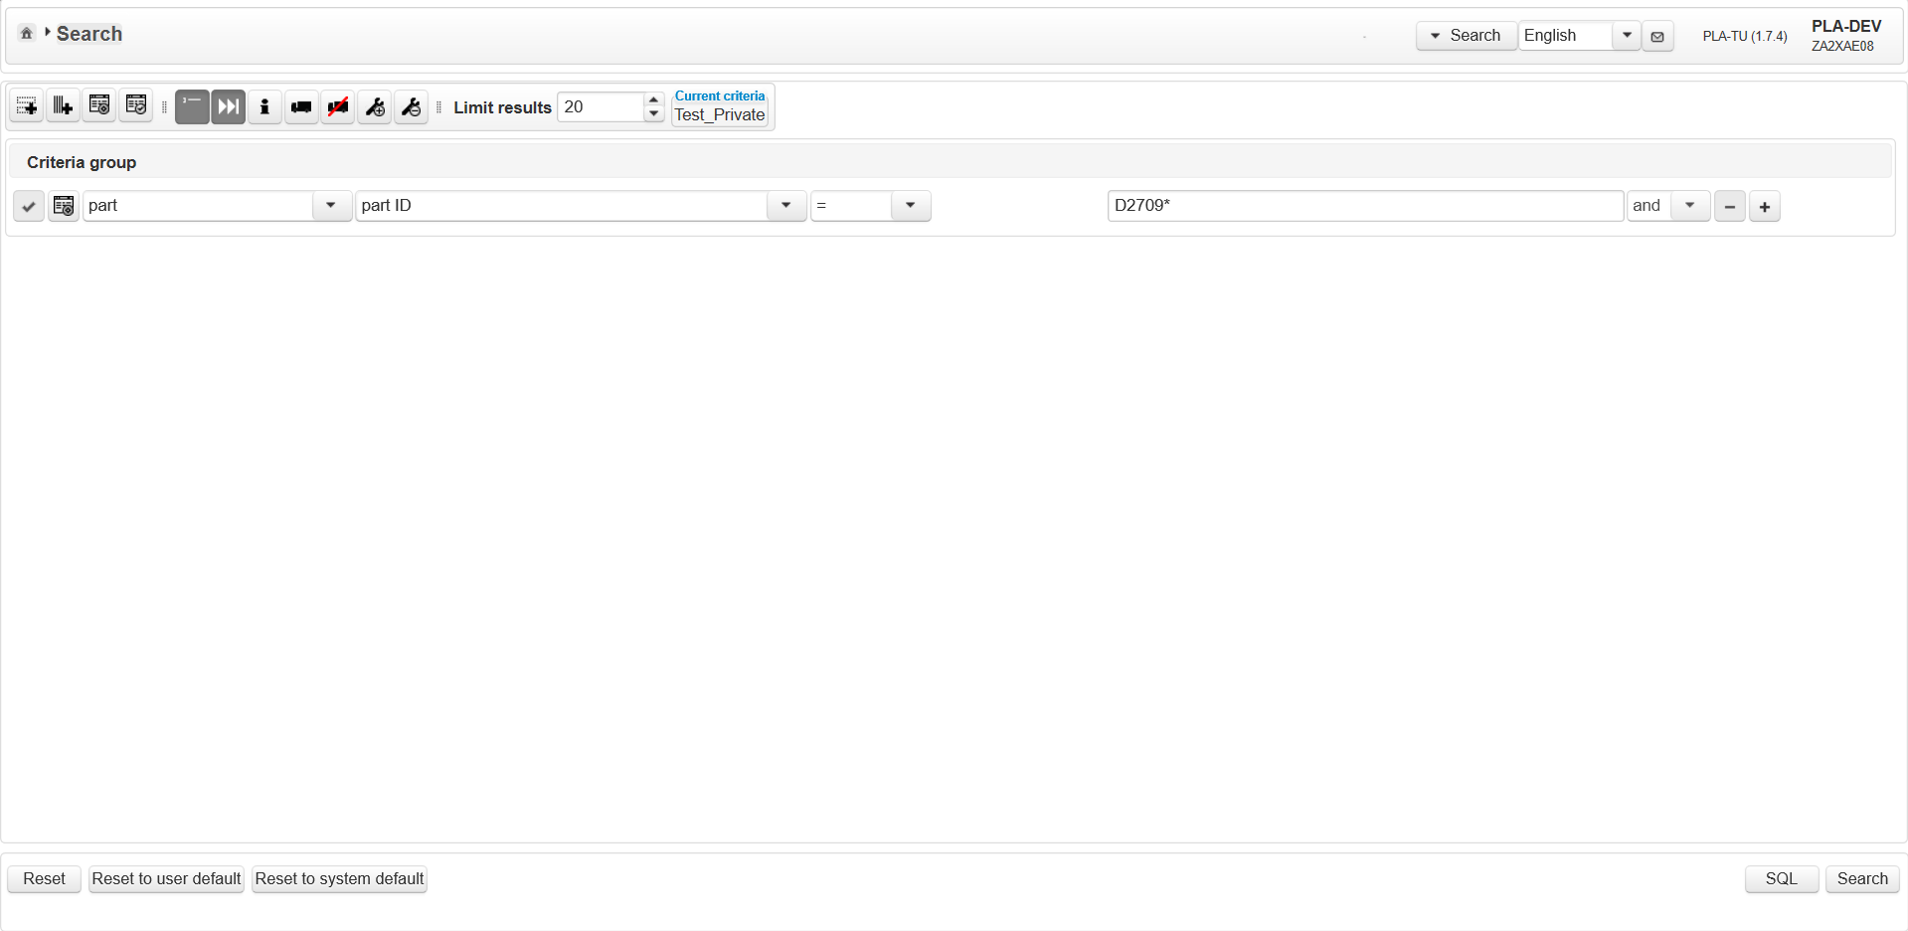
Perform show last operation
On Click it gets highlighted.
Click on Search button

Slide 56
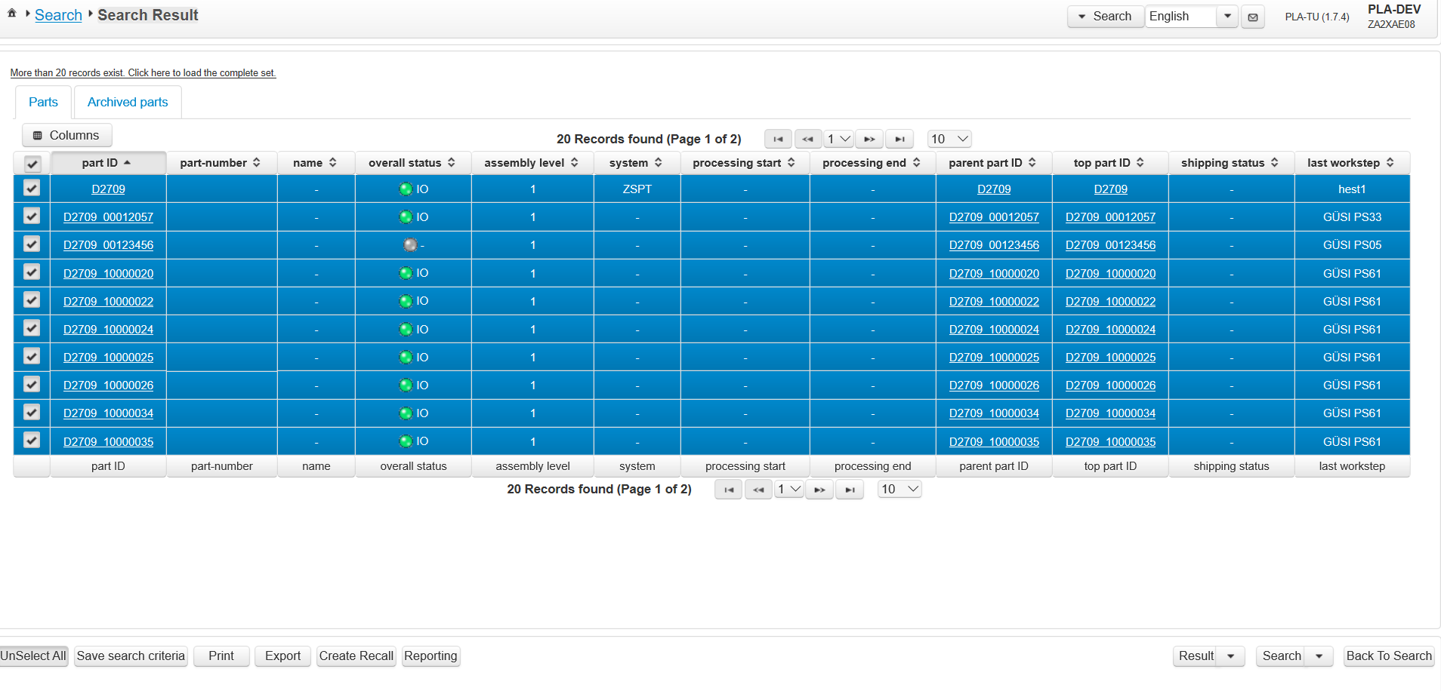
Perform show last operation
We have set the limit to 20 so only 20 parts are displayed, if we click on this link all the parts will be displayed
Last work step column is displayed This column shows what was the last operation of the part

Slide 57
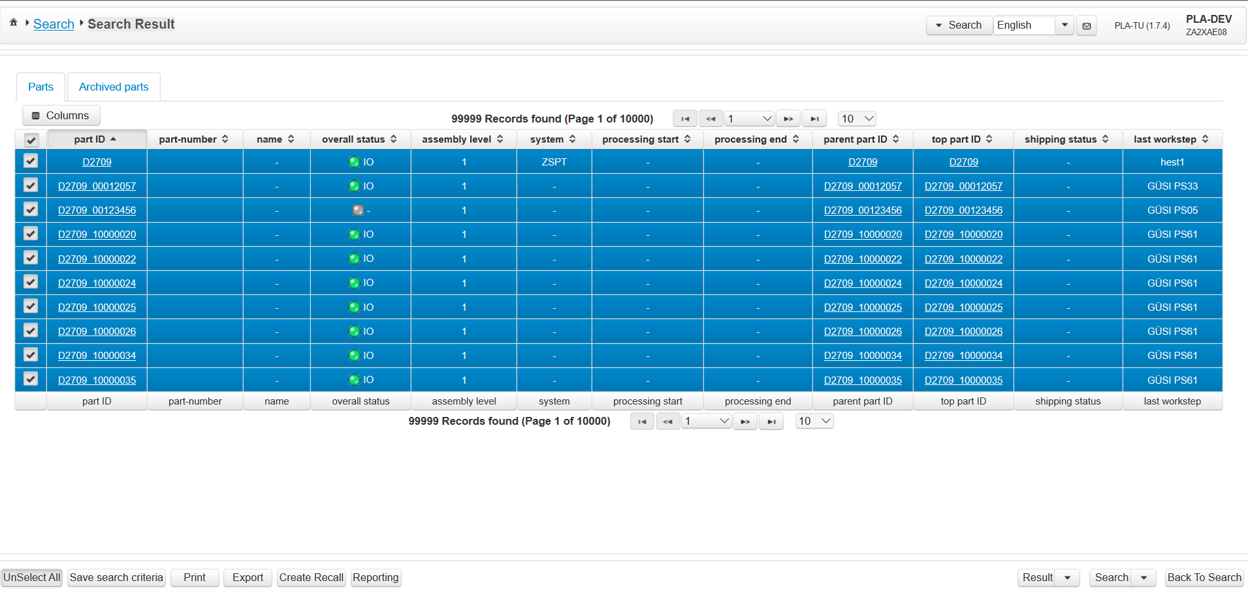
On Click of Show more link
All the parts are displayed. Total 99999 are displayed that is limit defined in the DB
Click on Back To Search button

Slide 58
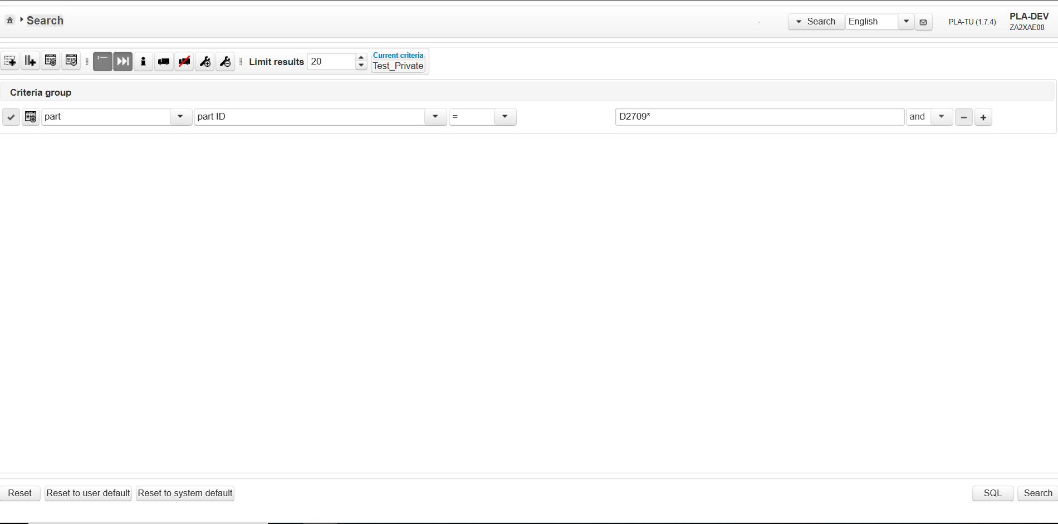
Click on recall info button
Click on Show last operation button again
Click on Show recall information button

Slide 59
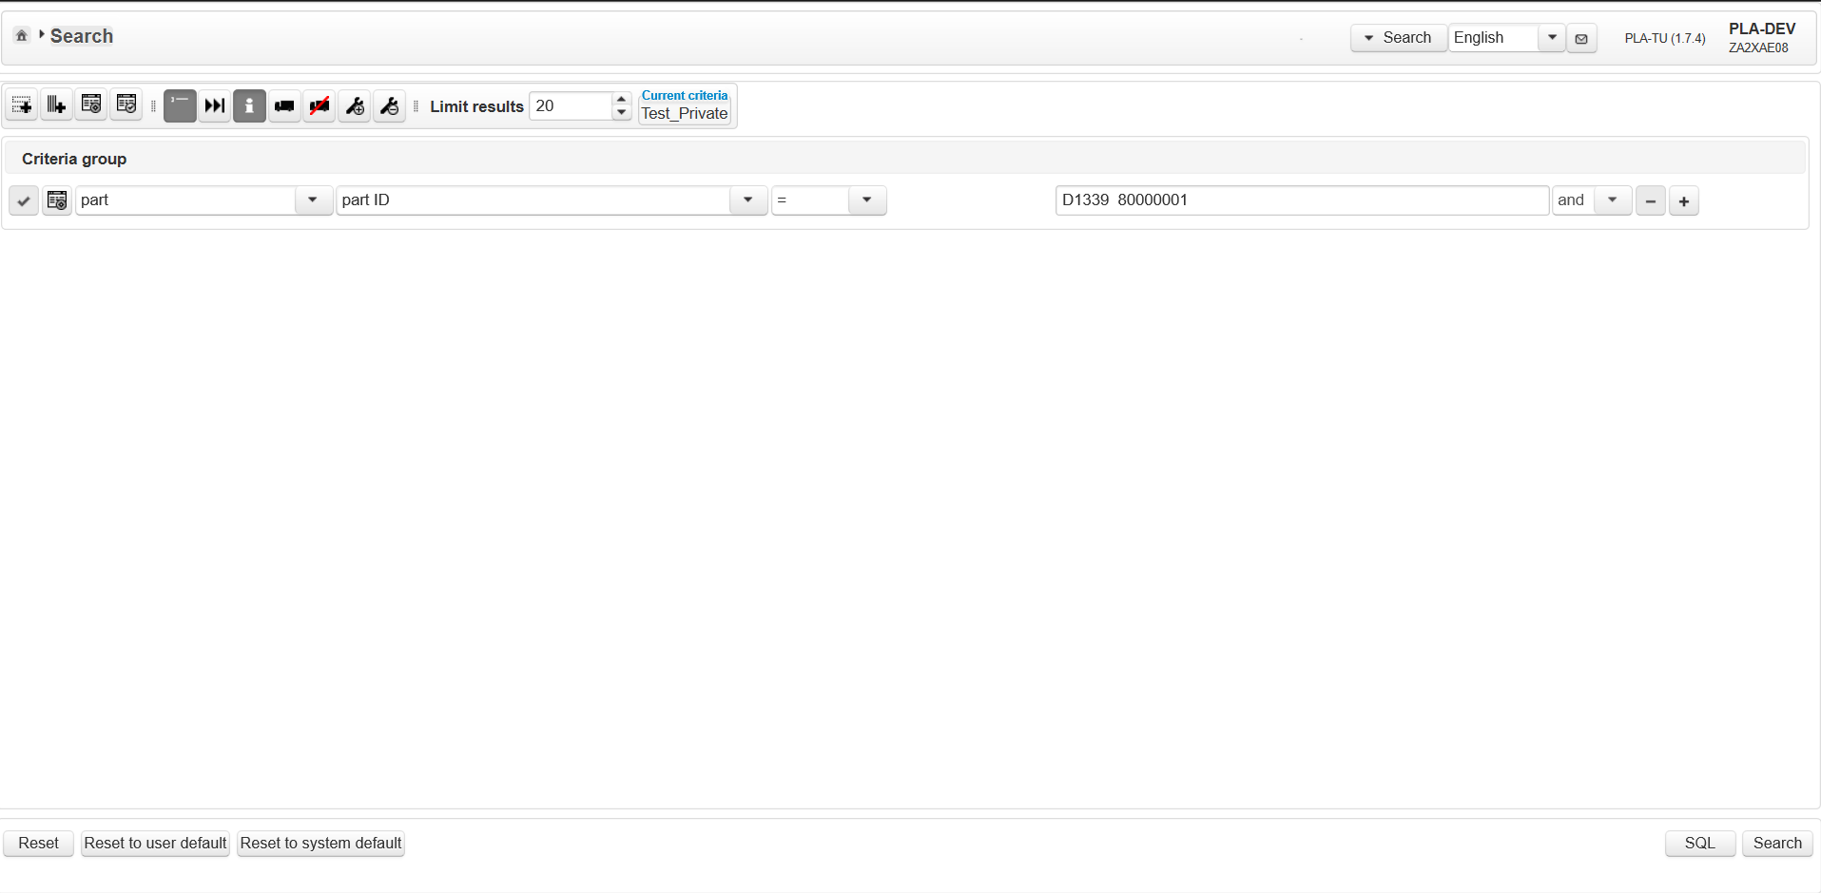
Click on recall info button
Show last information button is in Off state
Show recall information button is clicked and is in ON state
Set criteria part →part ID= D1339 80000001
Click on Search button

Slide 60
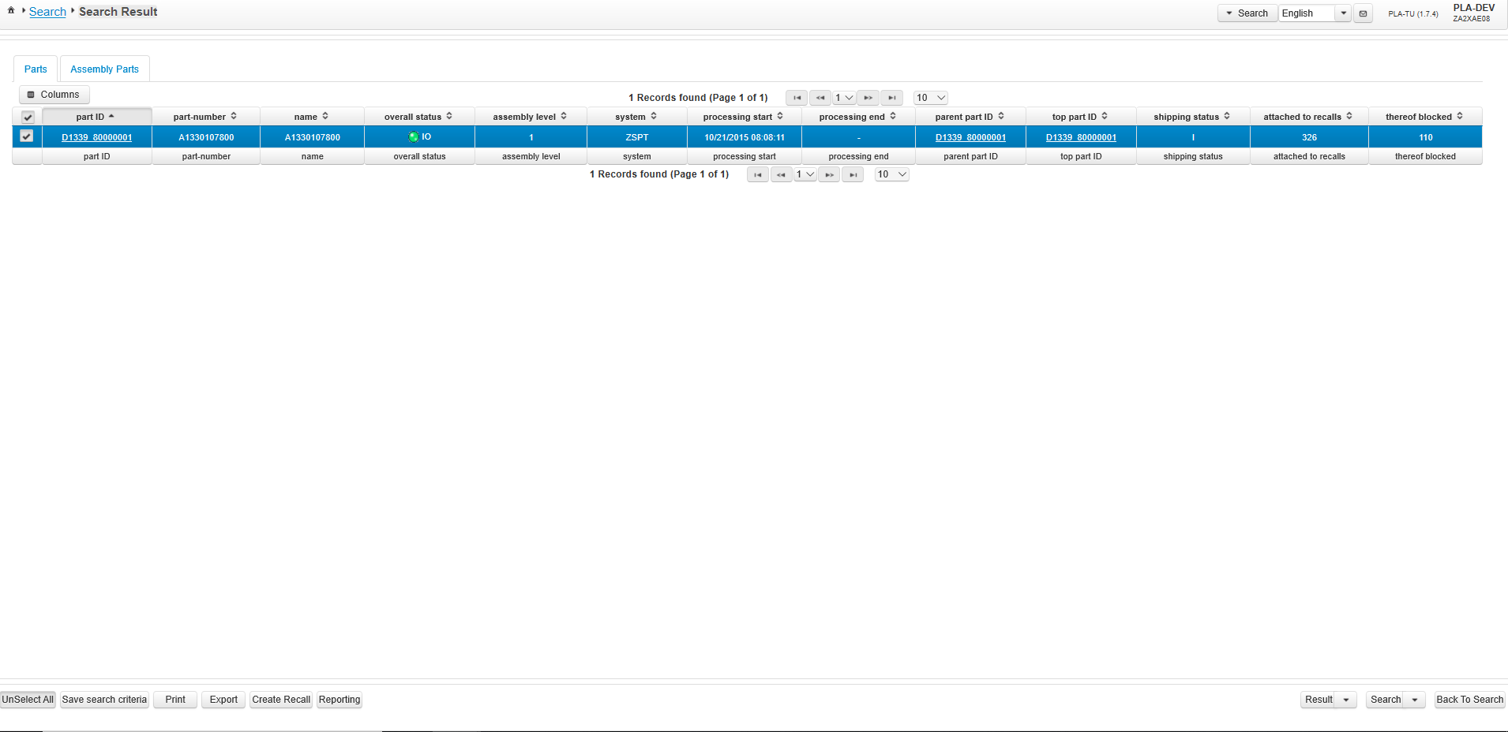
Click on recall info button
Attached to recalls and thereof blocked are displayed as additional columns
Click on home button
Attached to recall displays number of recalls created for the part D1339 80000001 and thereof blocked displays the count where part is blocked

Slide 61
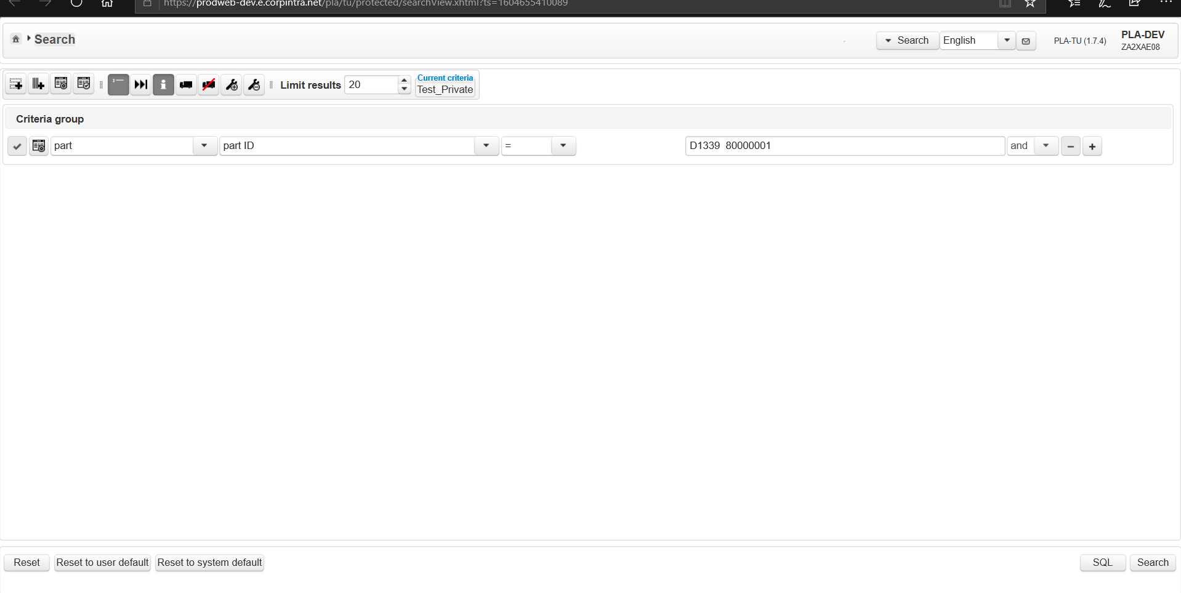
Click on recall info again and Click on Shipped parts
Click on Recall Info again
Click on Show only Shipped parts

Slide 62
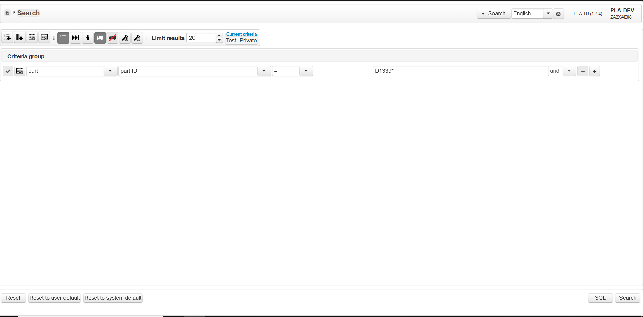
Click on Show on shipped parts and Click on Search button
Show only shipped parts is clicked and enabled
Show only unshipped parts is disabled
Set criteria part →part ID= D1339*
“ * “ works like like operator all the part starting with D1339 will be displayed
Click on Search button

Slide 63
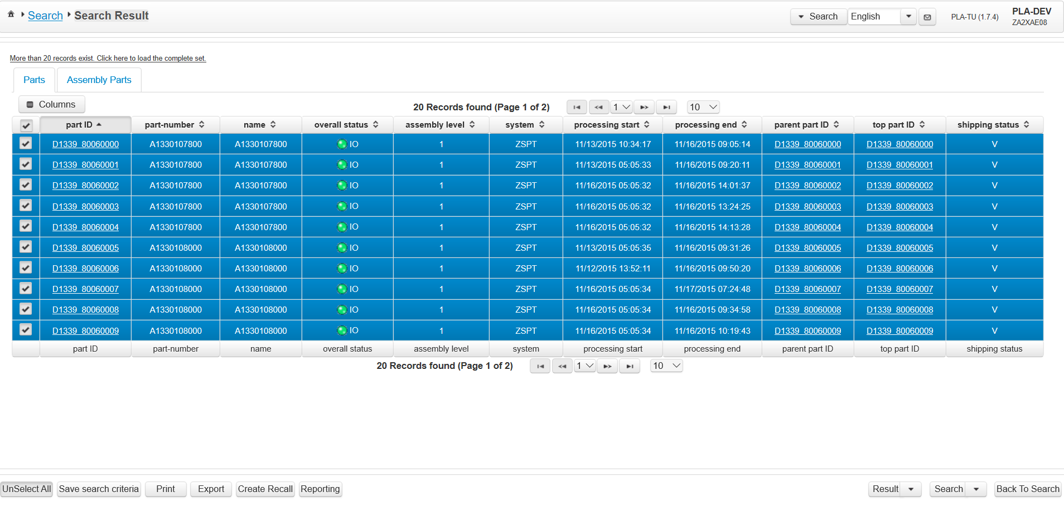
Parts which are shipped will have shipping status= V
Show only shipped parts is clicked and enabled
Show only unshipped parts is disabled
Set criteria part →part ID= D1339*
“ * “ works like like operator all the part starting with D1339 will be displayed
Click on Search button

